Slide 1



Innovation.
Education.
Training.

Slide 2




INNOVATION.
EDUCATION.
TRAINING.
Hello
TAMPA

Slide 3
Catch ‘Em All: Mastering Dynamics 365 Performance Like a Pokémon Pro

Slide 4


Speaker
Nathan Clouse
Technical Architect
Microsoft MVP 5x
Armanino

Slide 5
Intro
How can we get the most performance out of F&O?
Spot areas we can improve and act on our own
Collect info on areas we want help improving
Areas we can improve with admins and developers

Slide 6

What Microsoft Delivers
A good product using good technology that delivers good results with good performance
Its up to us to make it great for our organization

Slide 7

Spotting Issues
Visible
Slow Screens or reports
Excel Add-in going slow
Waiting
Not-So-Visible
Batch jobs
DMF
Integrations

Slide 8

Forms
If a form is slow…
Remove some columns
Don’t use it? Don’t need it!

Slide 9
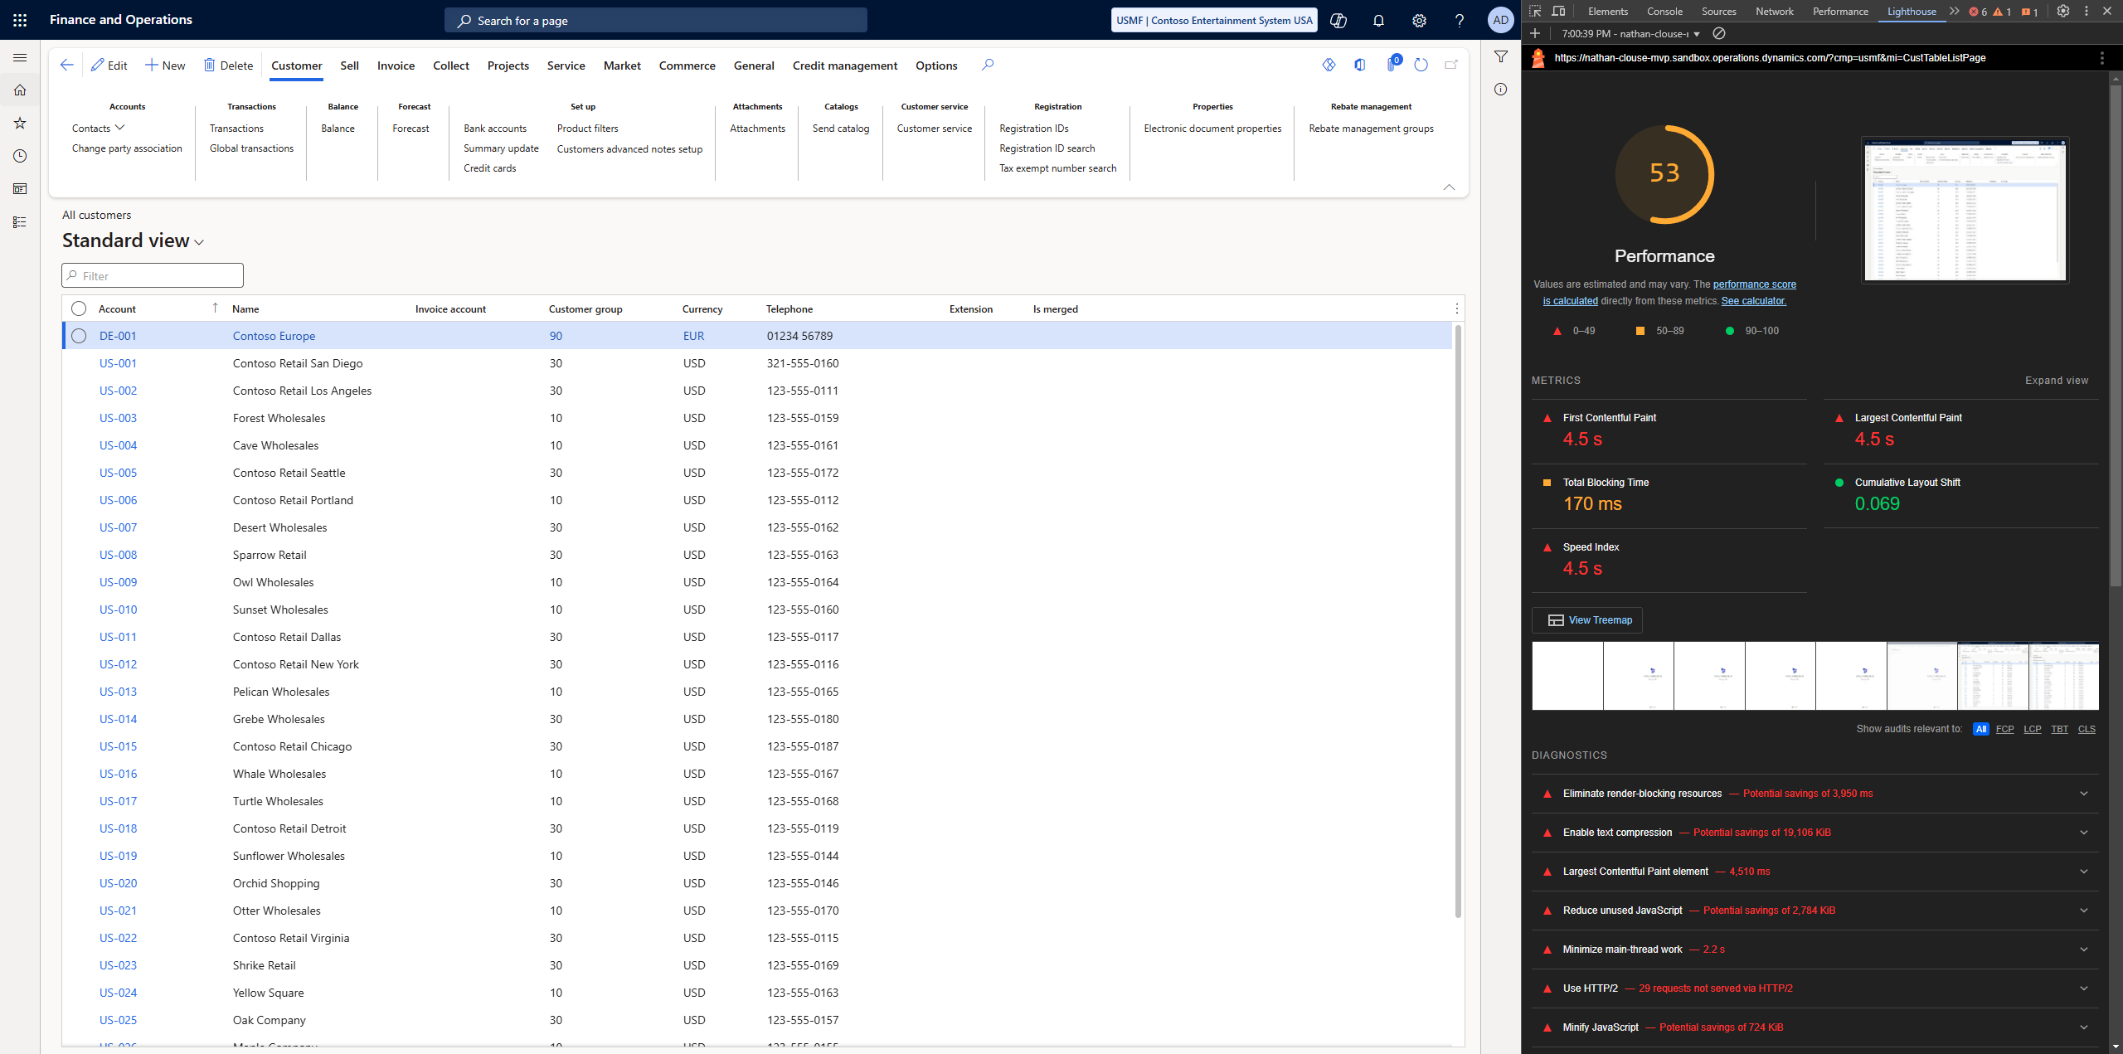
Forms

Slide 10
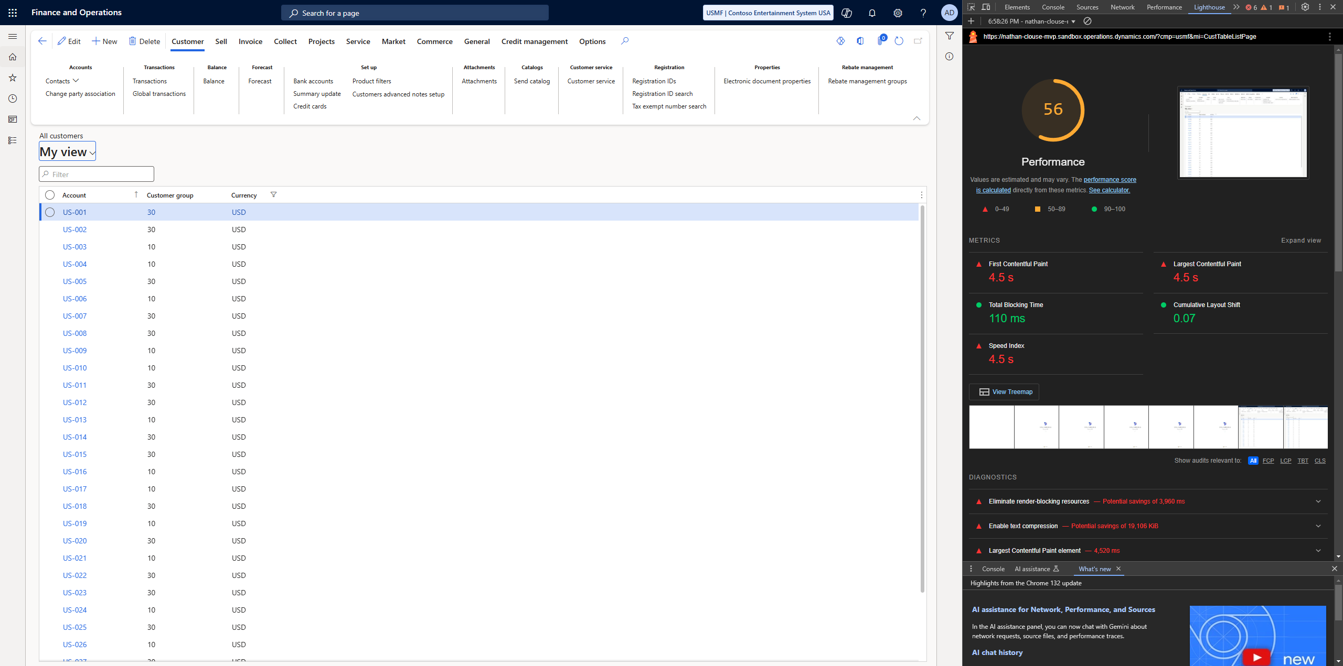
Forms

Slide 11

Workspaces
If you have common views you use or have a lot you want to use…
Make a workspace
Home page > right click in workspaces > personalize workspaces > Add pages > Workspace

Slide 12
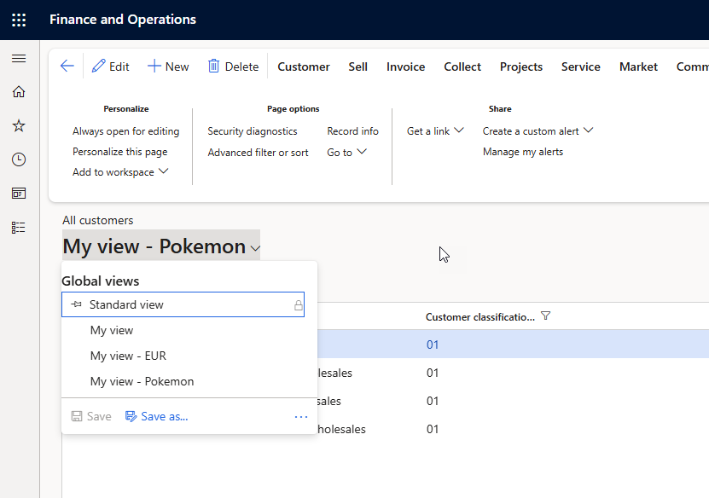


Slide 13
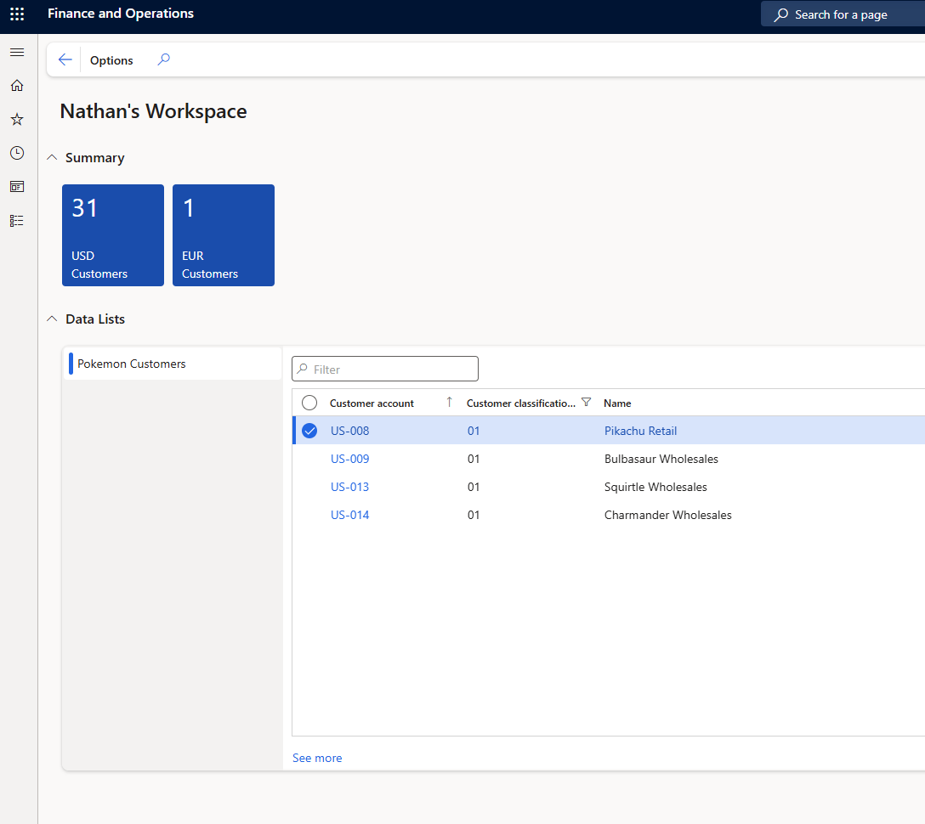


Slide 14

Excel Add In
The Excel add in can be clunky and slow
First, see if any new data entities are available
Next, see if any other data entities are available that are faster

Slide 15
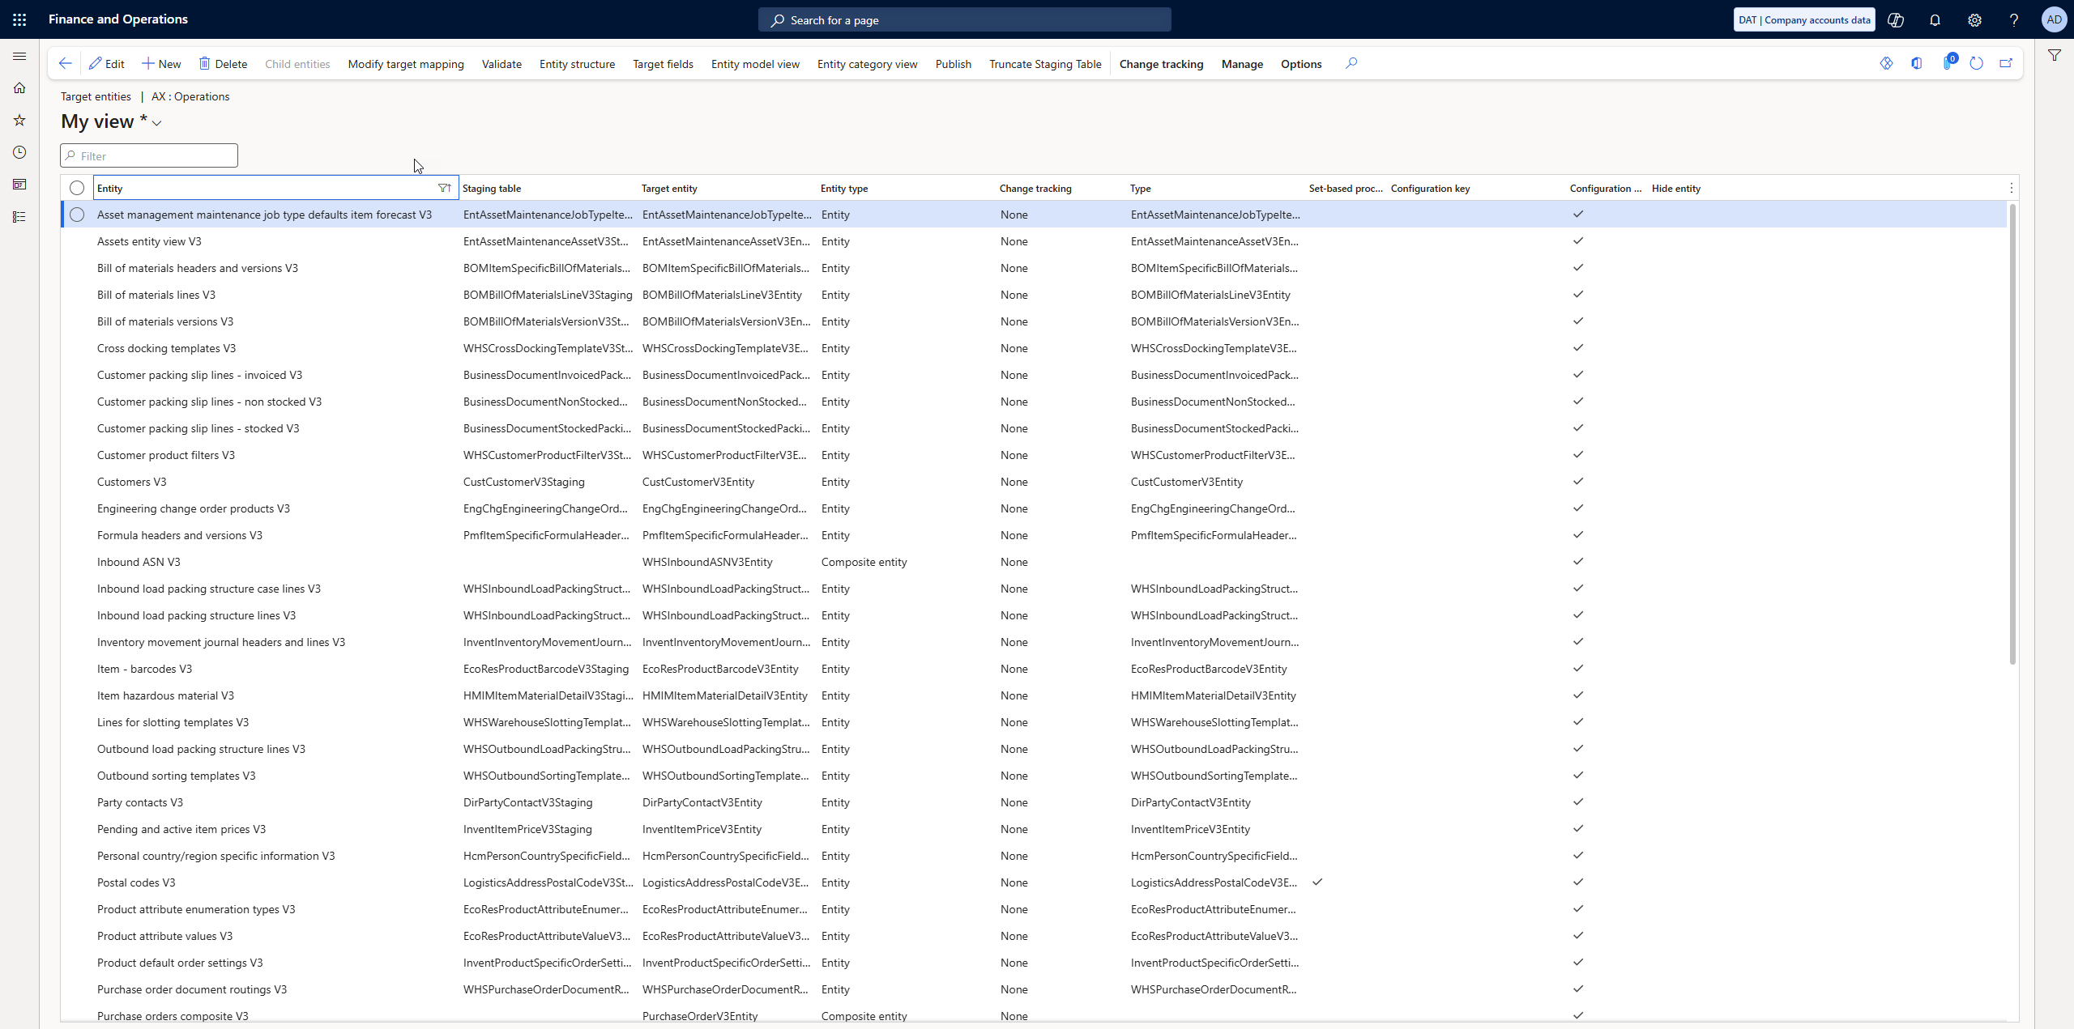

Slide 16
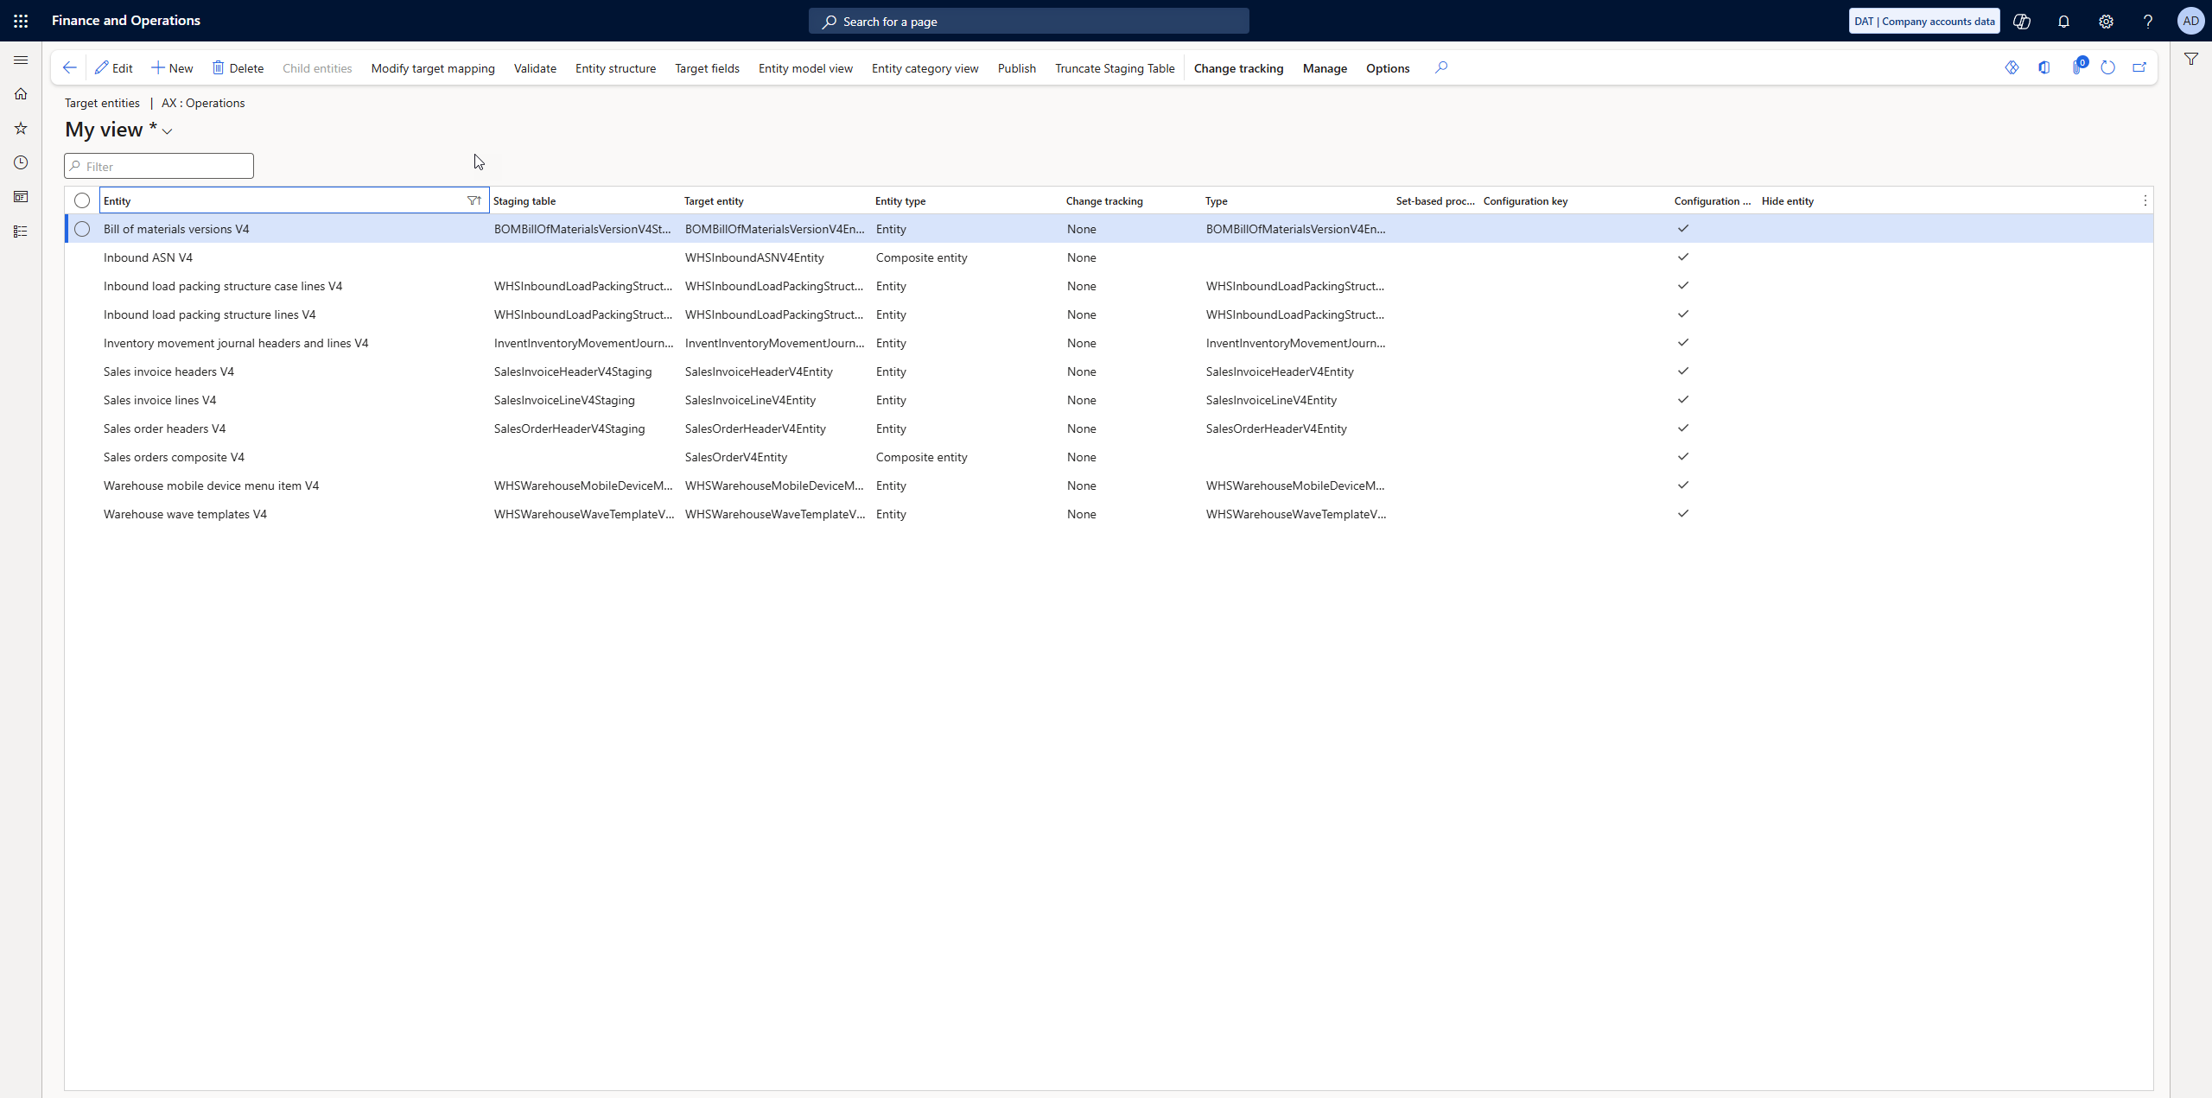

Slide 17
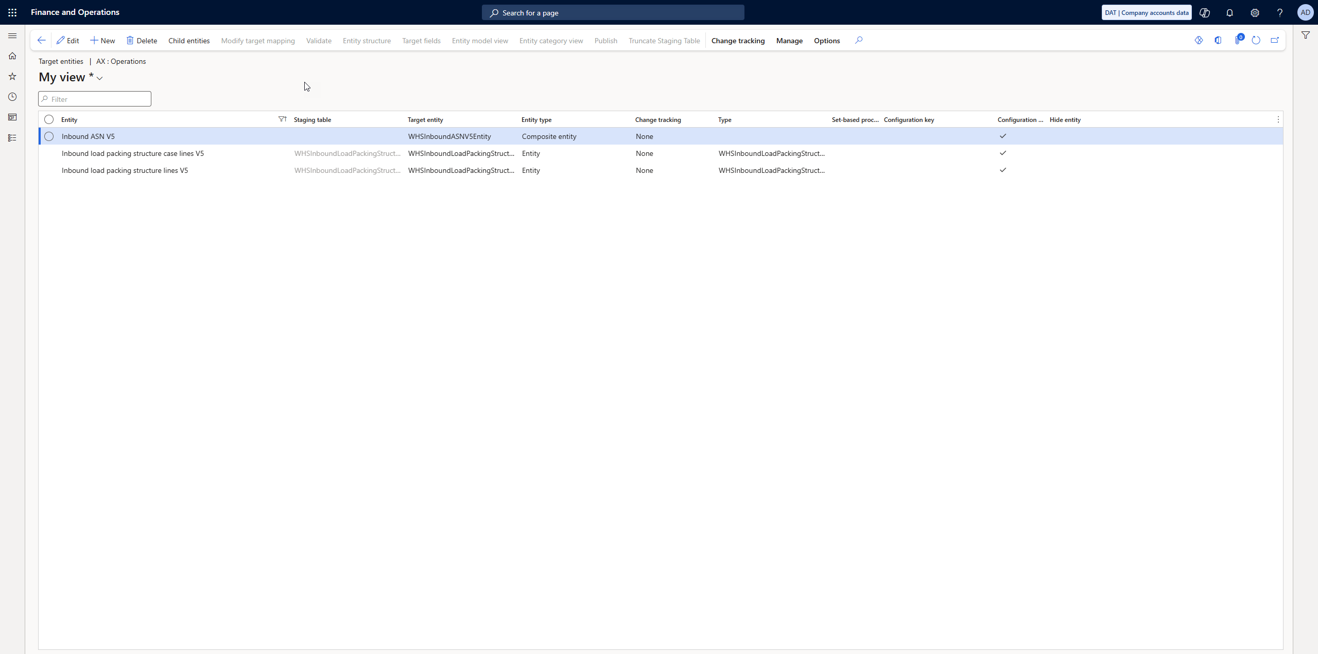

Slide 18
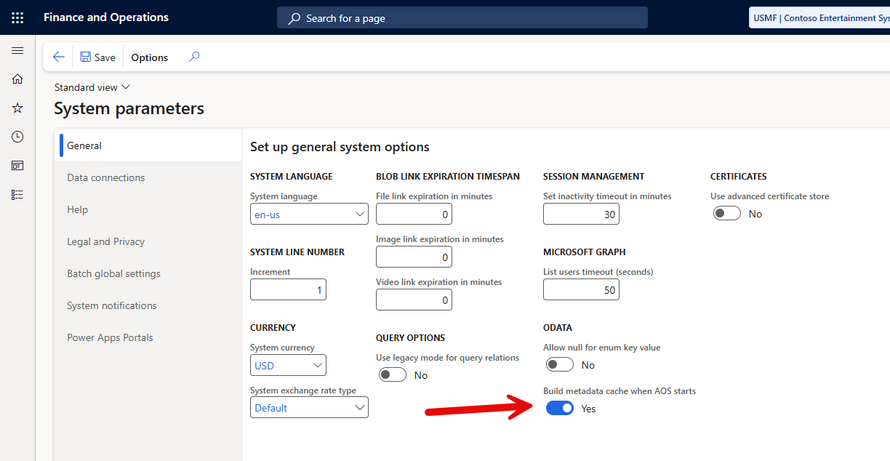

Slide 19
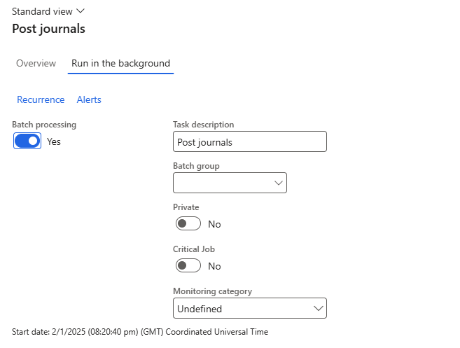

Waiting
If you’re waiting, is using batch an option?

Slide 20
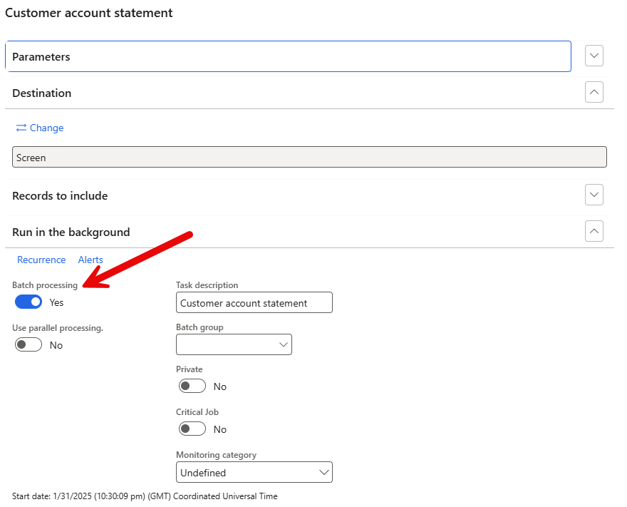

Slide 21
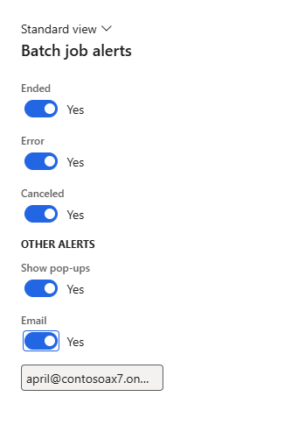


Slide 22

Batch Jobs ( and History )
Identify long running batch jobs and review history
System Administration > Inquiries > Batch Jobs
System Administration > Workspaces > System Administration

Slide 23
https://nathan-clouse.sandbox.operations.dynamics.com/?cmp=usmf&mi=BatchJob
https://nathan-clouse.sandbox.operations.dynamics.com/?cmp=usmf&mi=BatchJobHistory

Slide 24
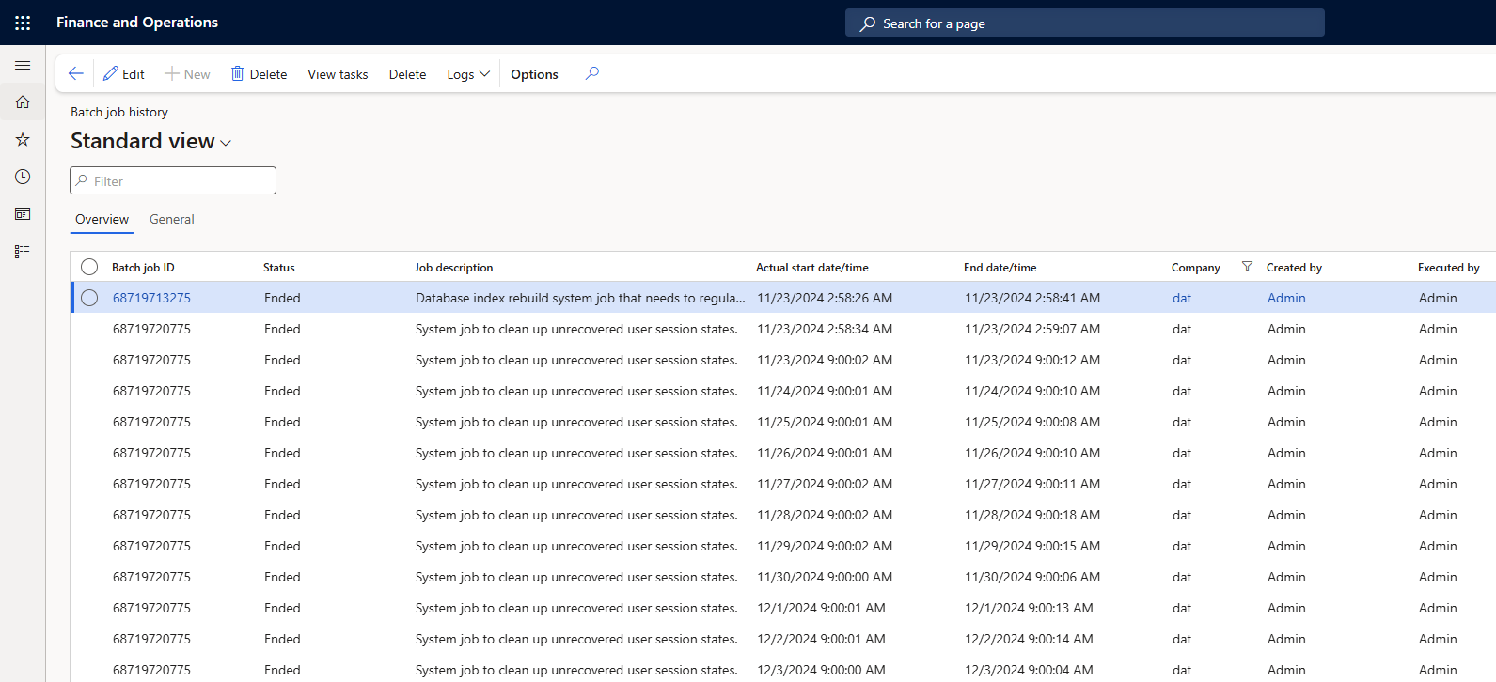
Notes:
Export to excel, do adhoc reporting

Slide 25
Add chart here

Slide 26

DMF
If DMF is slow, run cleanup
This cleans up data that most likely isn’t needed
Databases with less data typically are faster

Slide 27
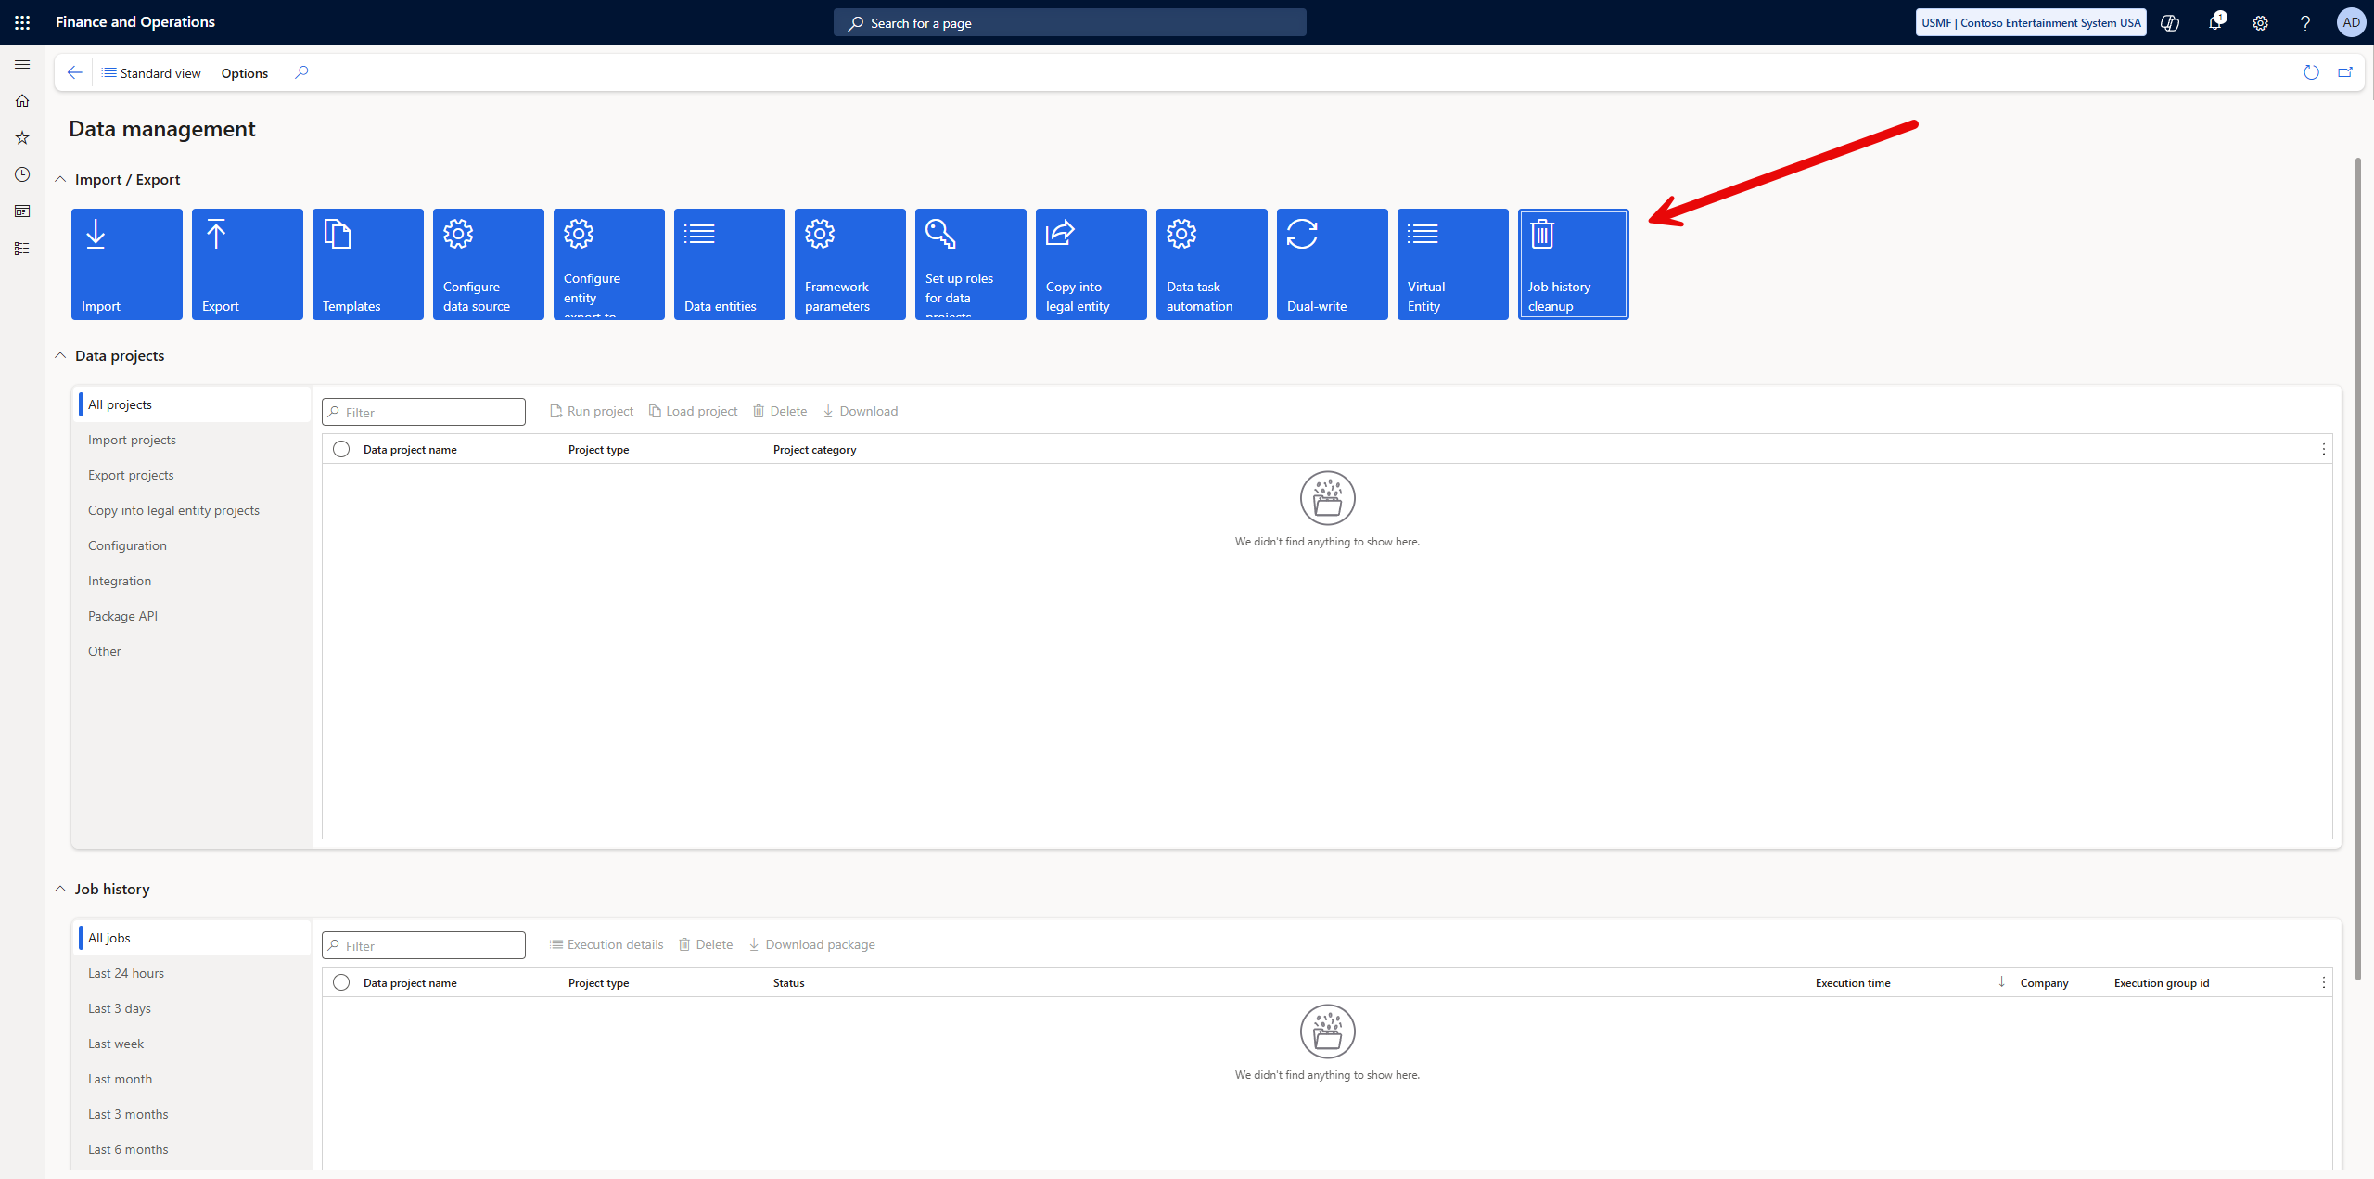

Slide 28
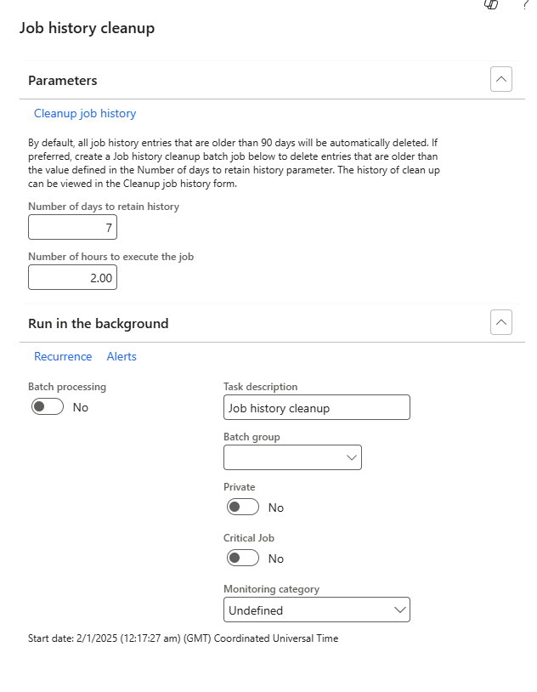


Slide 29

Brief side quest to talk about capacity
Storage Capacity
Database Usage
Blob Usage
Nothing to do with system performance
Batch Capacity
Threads available
Batch Job Tasks that are available to run
Amount of resources dedicated to batch workload

Slide 30

Integrations
DMF, Custom Services, and OData
LCS tools are being removed so some visibility is limited
Endpoints aren’t managed so no layer there to help either
Use Azure API Manager for API Endpoints
Limitations from LCS on logging – no automation

Slide 31
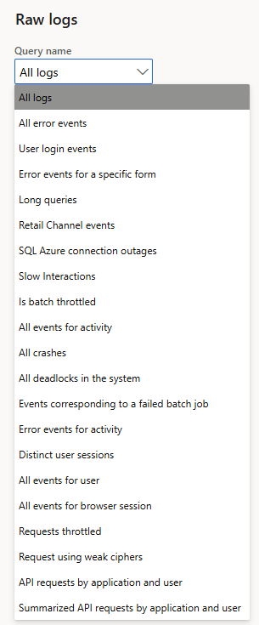

LCS
Going away in the future
Replaced with Power Platform Admin Center (PPAC)

Slide 32
Telemetry
https://community.dynamics.com/blogs/post/?postid=b8014884-9aa3-4fdb-8e2a-b3440d01a79a
https://alexdmeyer.com/2023/10/03/using-telemetry-data-for-read-auditing-in-d365fo/
https://github.com/microsoft/Dynamics-365-FastTrack-FSCM-Telemetry-Samples

Slide 33

Collecting Info

Slide 34

Task Recorder
Tools > Task Recorder > Start
Collects button clicks, form opens, etc. for “thing that is slow”

Slide 35

“Performance Report”
Task Recording
Include Word Doc, Developer recording, and .axtr
Include the legal entity/company, date and time of day with time zone
Use Teams to record your screen if you can ( have a meeting with yourself )

Slide 36
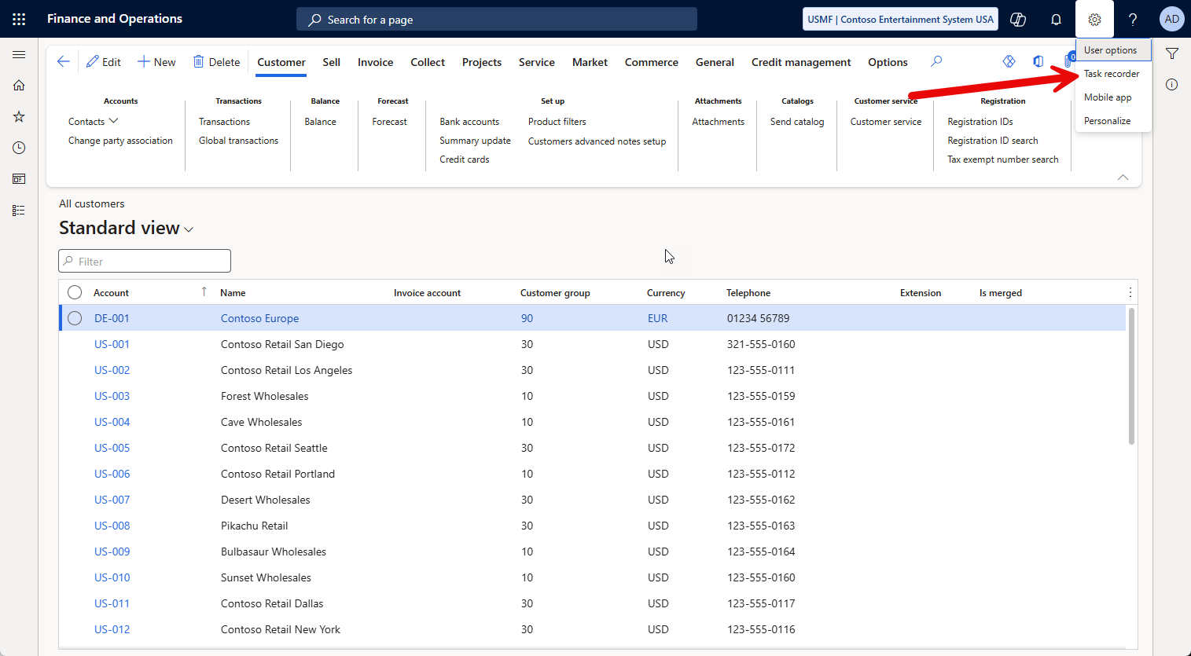

Slide 37
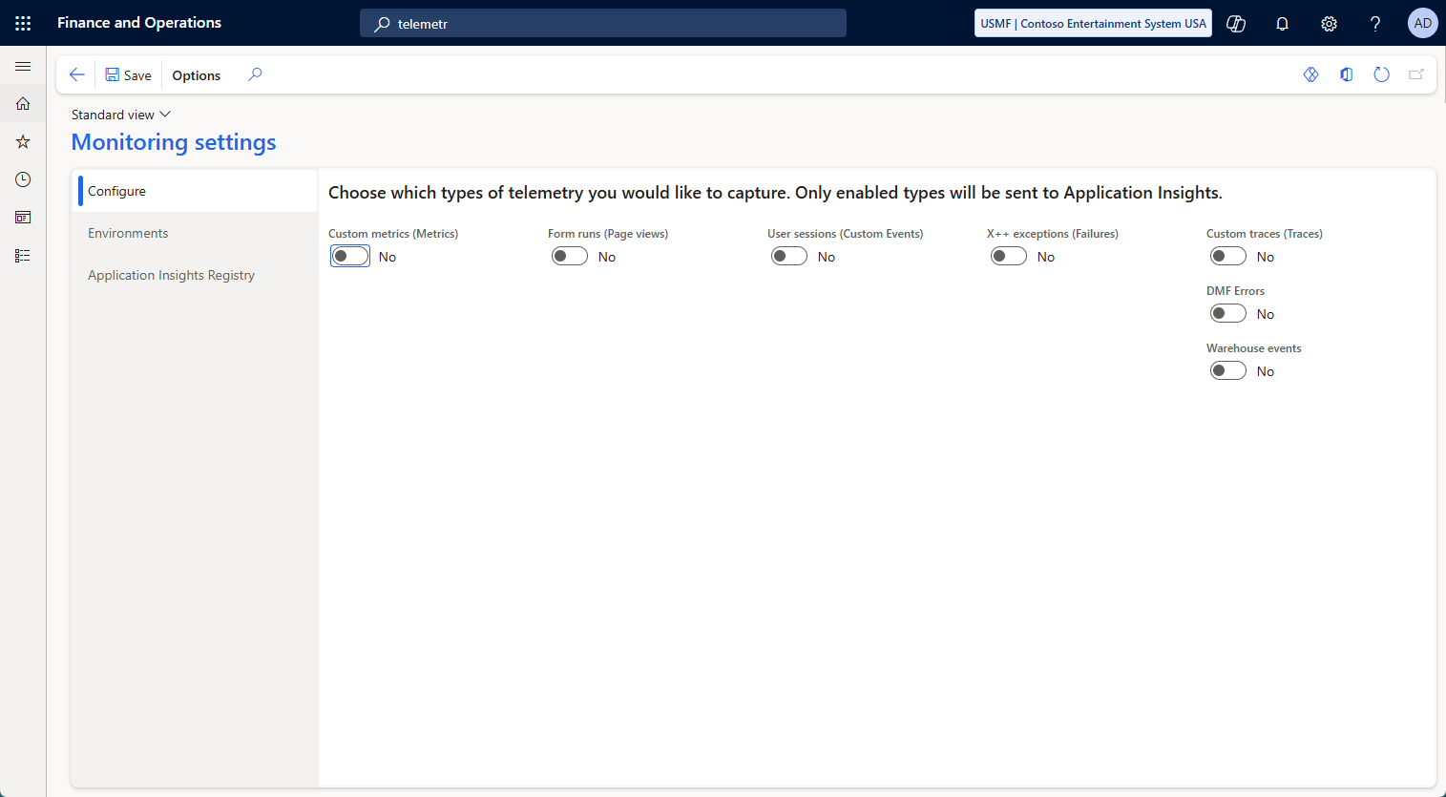
Telemetry
Turn on telemetry
Custom Metrics
Form runs ( Page Views)
User Sessions
X++ exceptions
Custom Traces
DMF Errors
Warehouse events

Slide 38
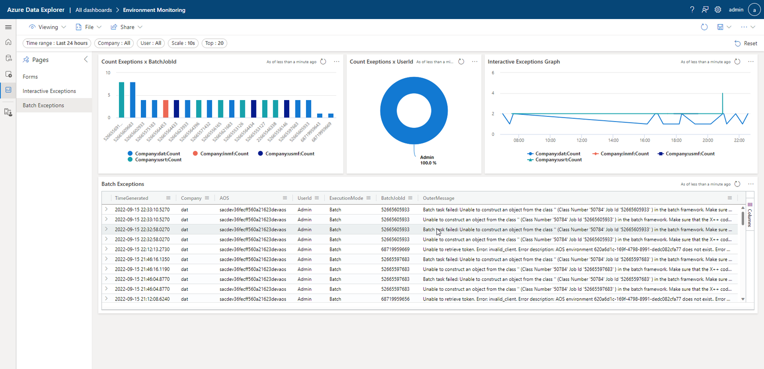
Notes:
Credit: https://samuelardilacarreno.com/2022/09/17/monitoring-and-telemetry-for-dynamics-365-finance-and-operations/

Slide 39

LCS
Limited insight
Reducing functionality over time
No automation available for most logging functionality
Slow

Slide 40
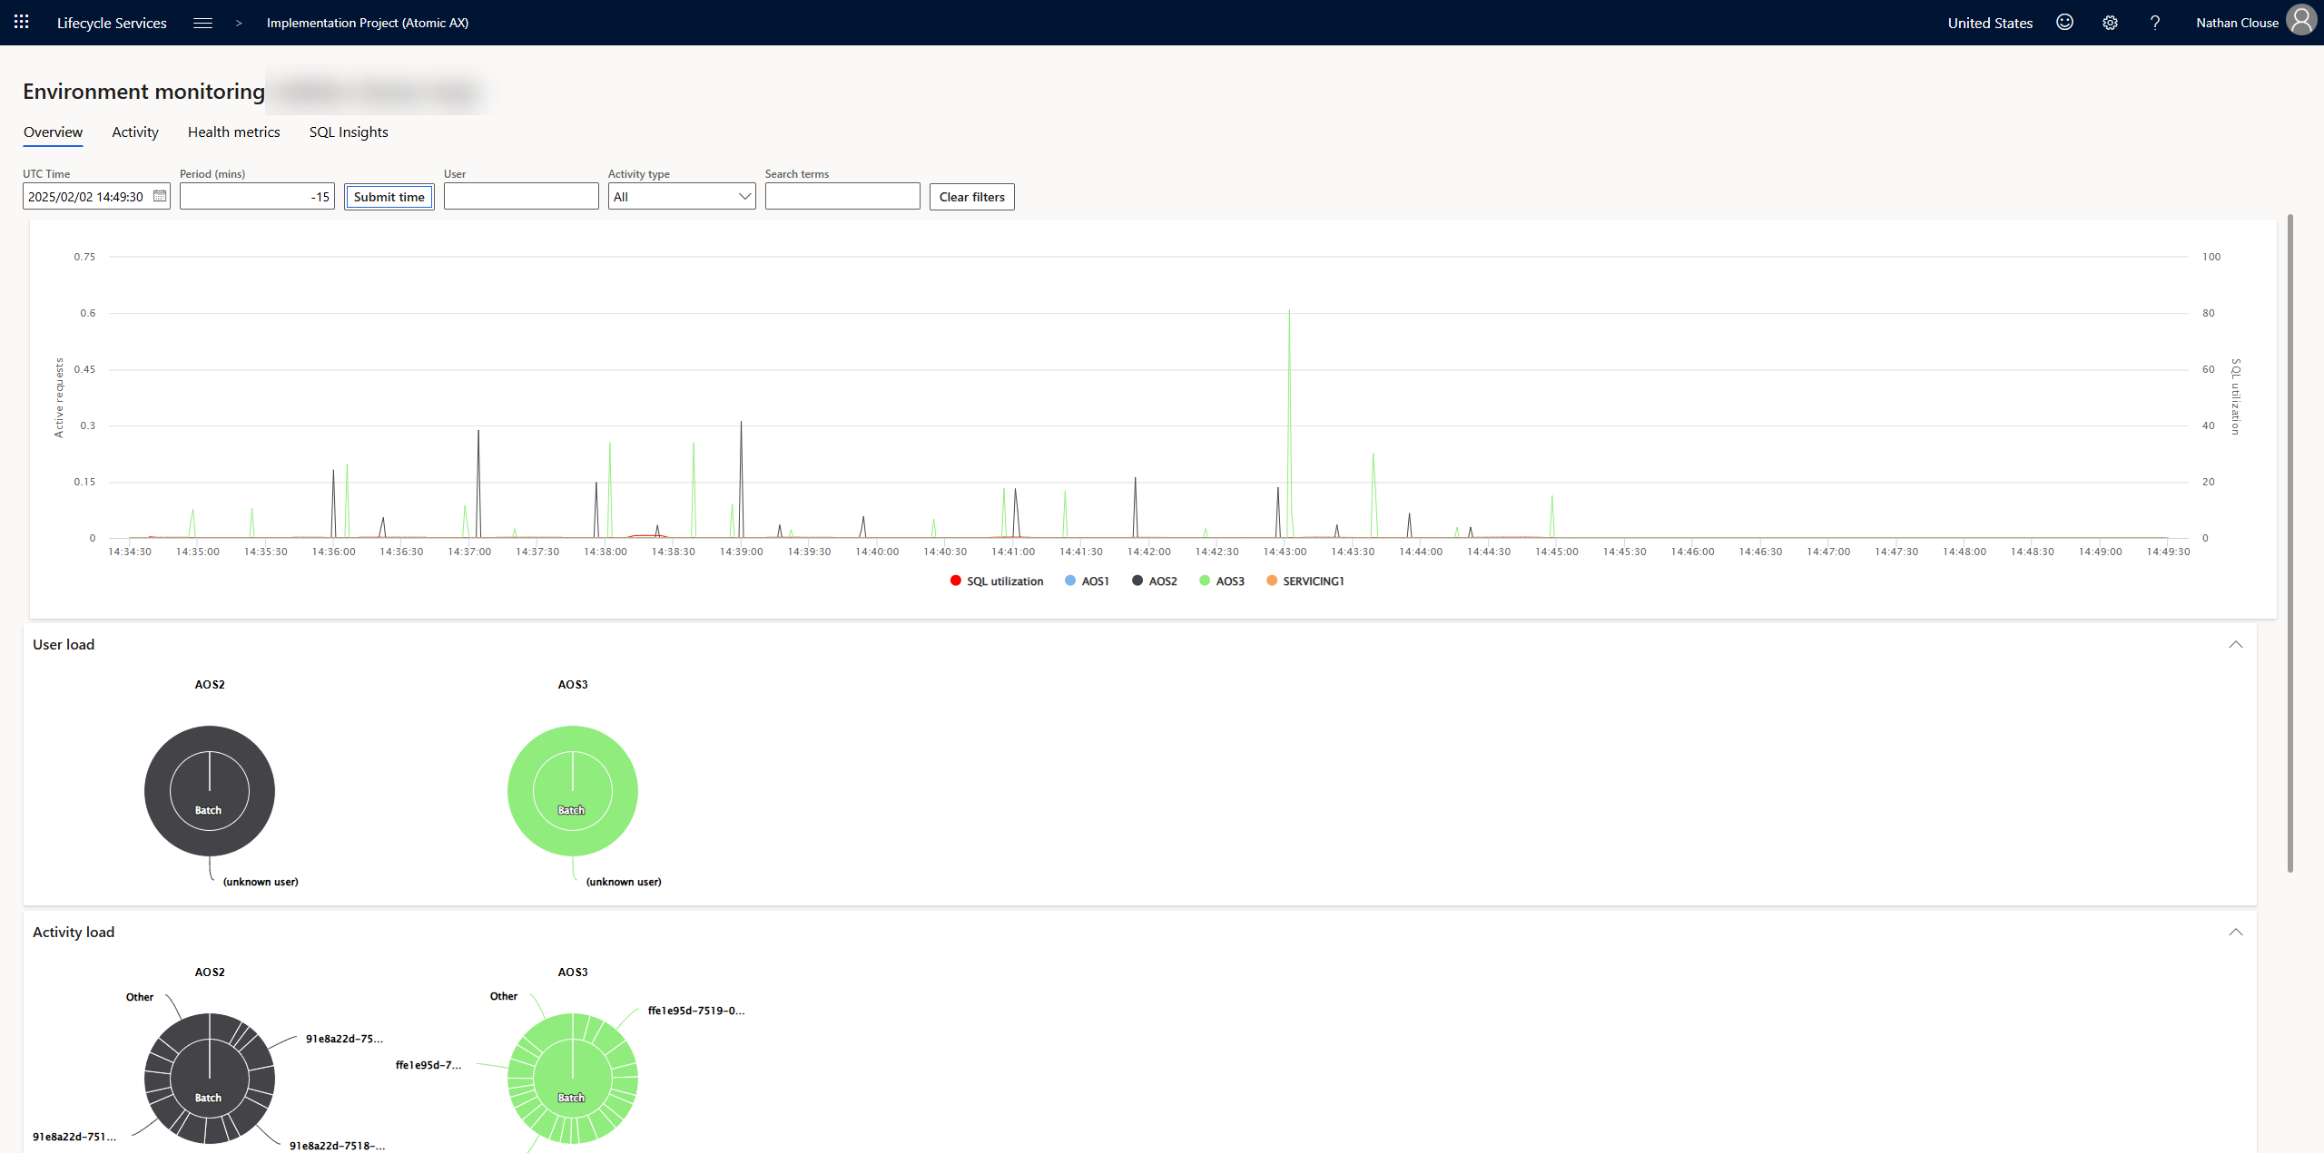
LCS

Slide 41
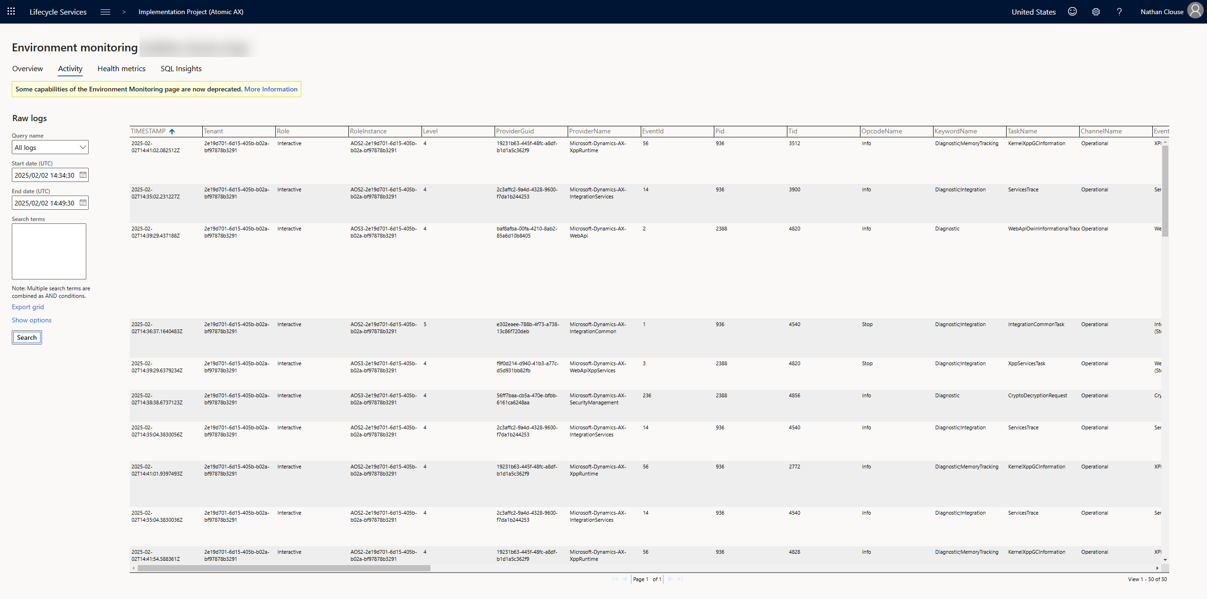
LCS

Slide 42
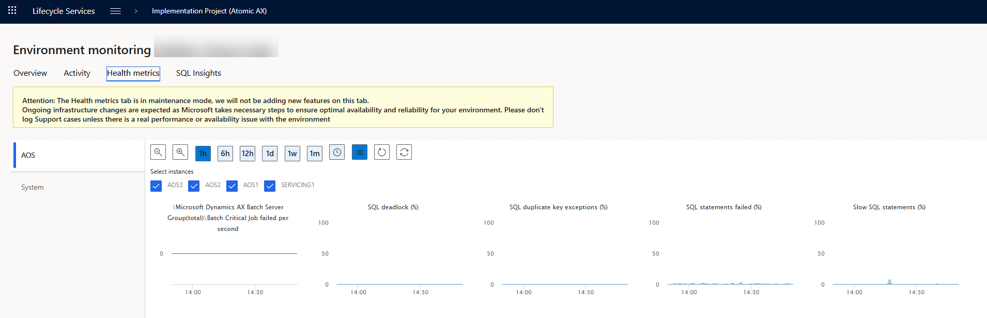
LCS

Slide 43
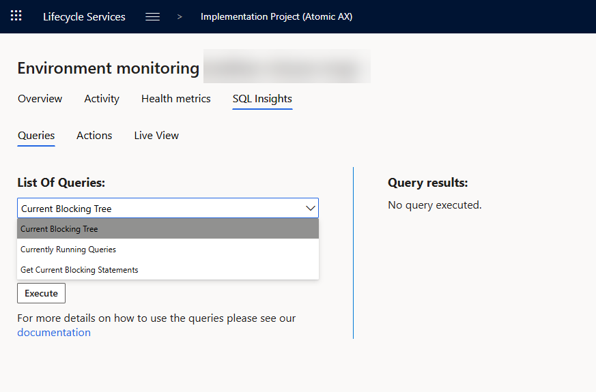
LCS

Slide 44
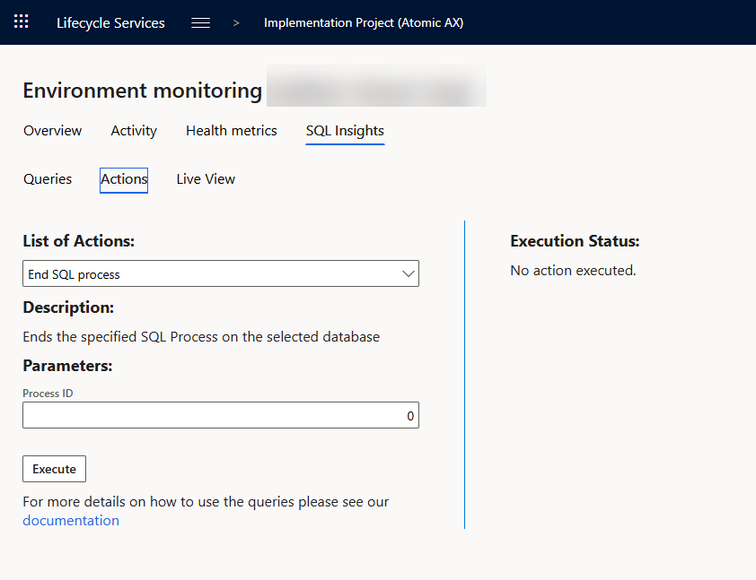
LCS

Slide 45
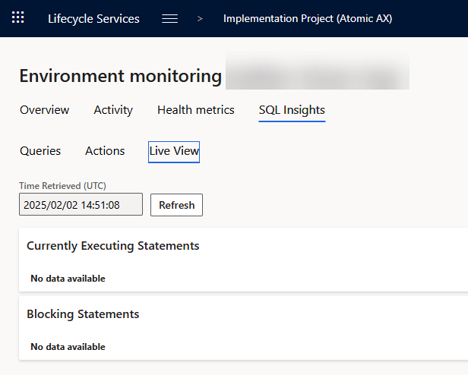
LCS

Slide 46

Trace Parser
What is a trace?
Detailed log of events, system calls, SQL queries, and resource usage captured while a specific task is being executed
Help > Trace

Slide 47
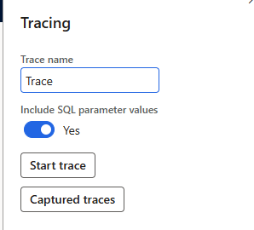
SQL Parameters
Gives more insight, “costs” a little more when on
Only admins can see previous traces
Users need “System Tracing user” to capture a trace

Slide 48

Parsing A Trace
Found on VHD and VMs.
“Microsoft Dynamics 365 Unified Operations - Trace Parser” in start menu
In UDE assets

Slide 49
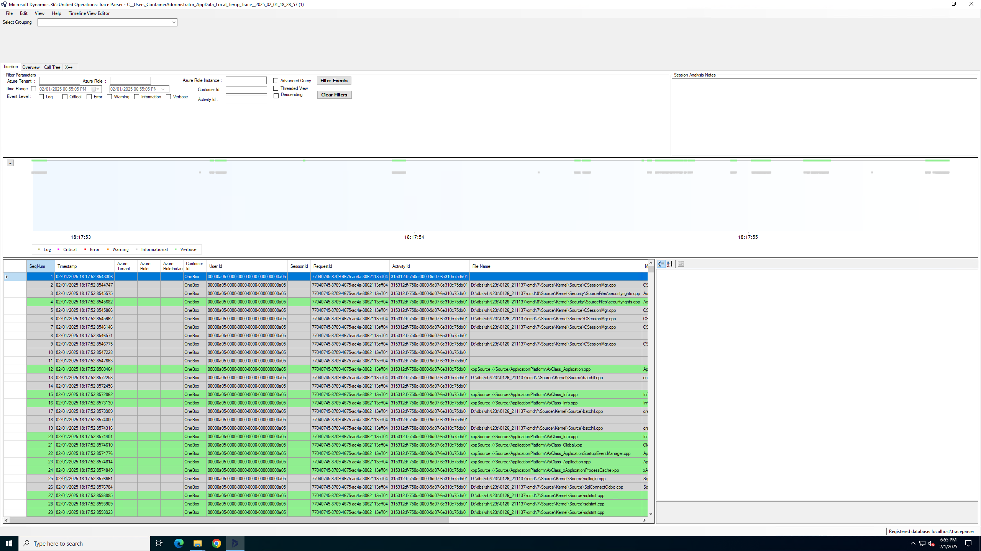

Slide 50
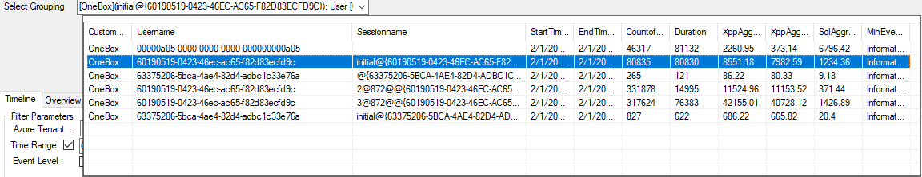

Slide 51
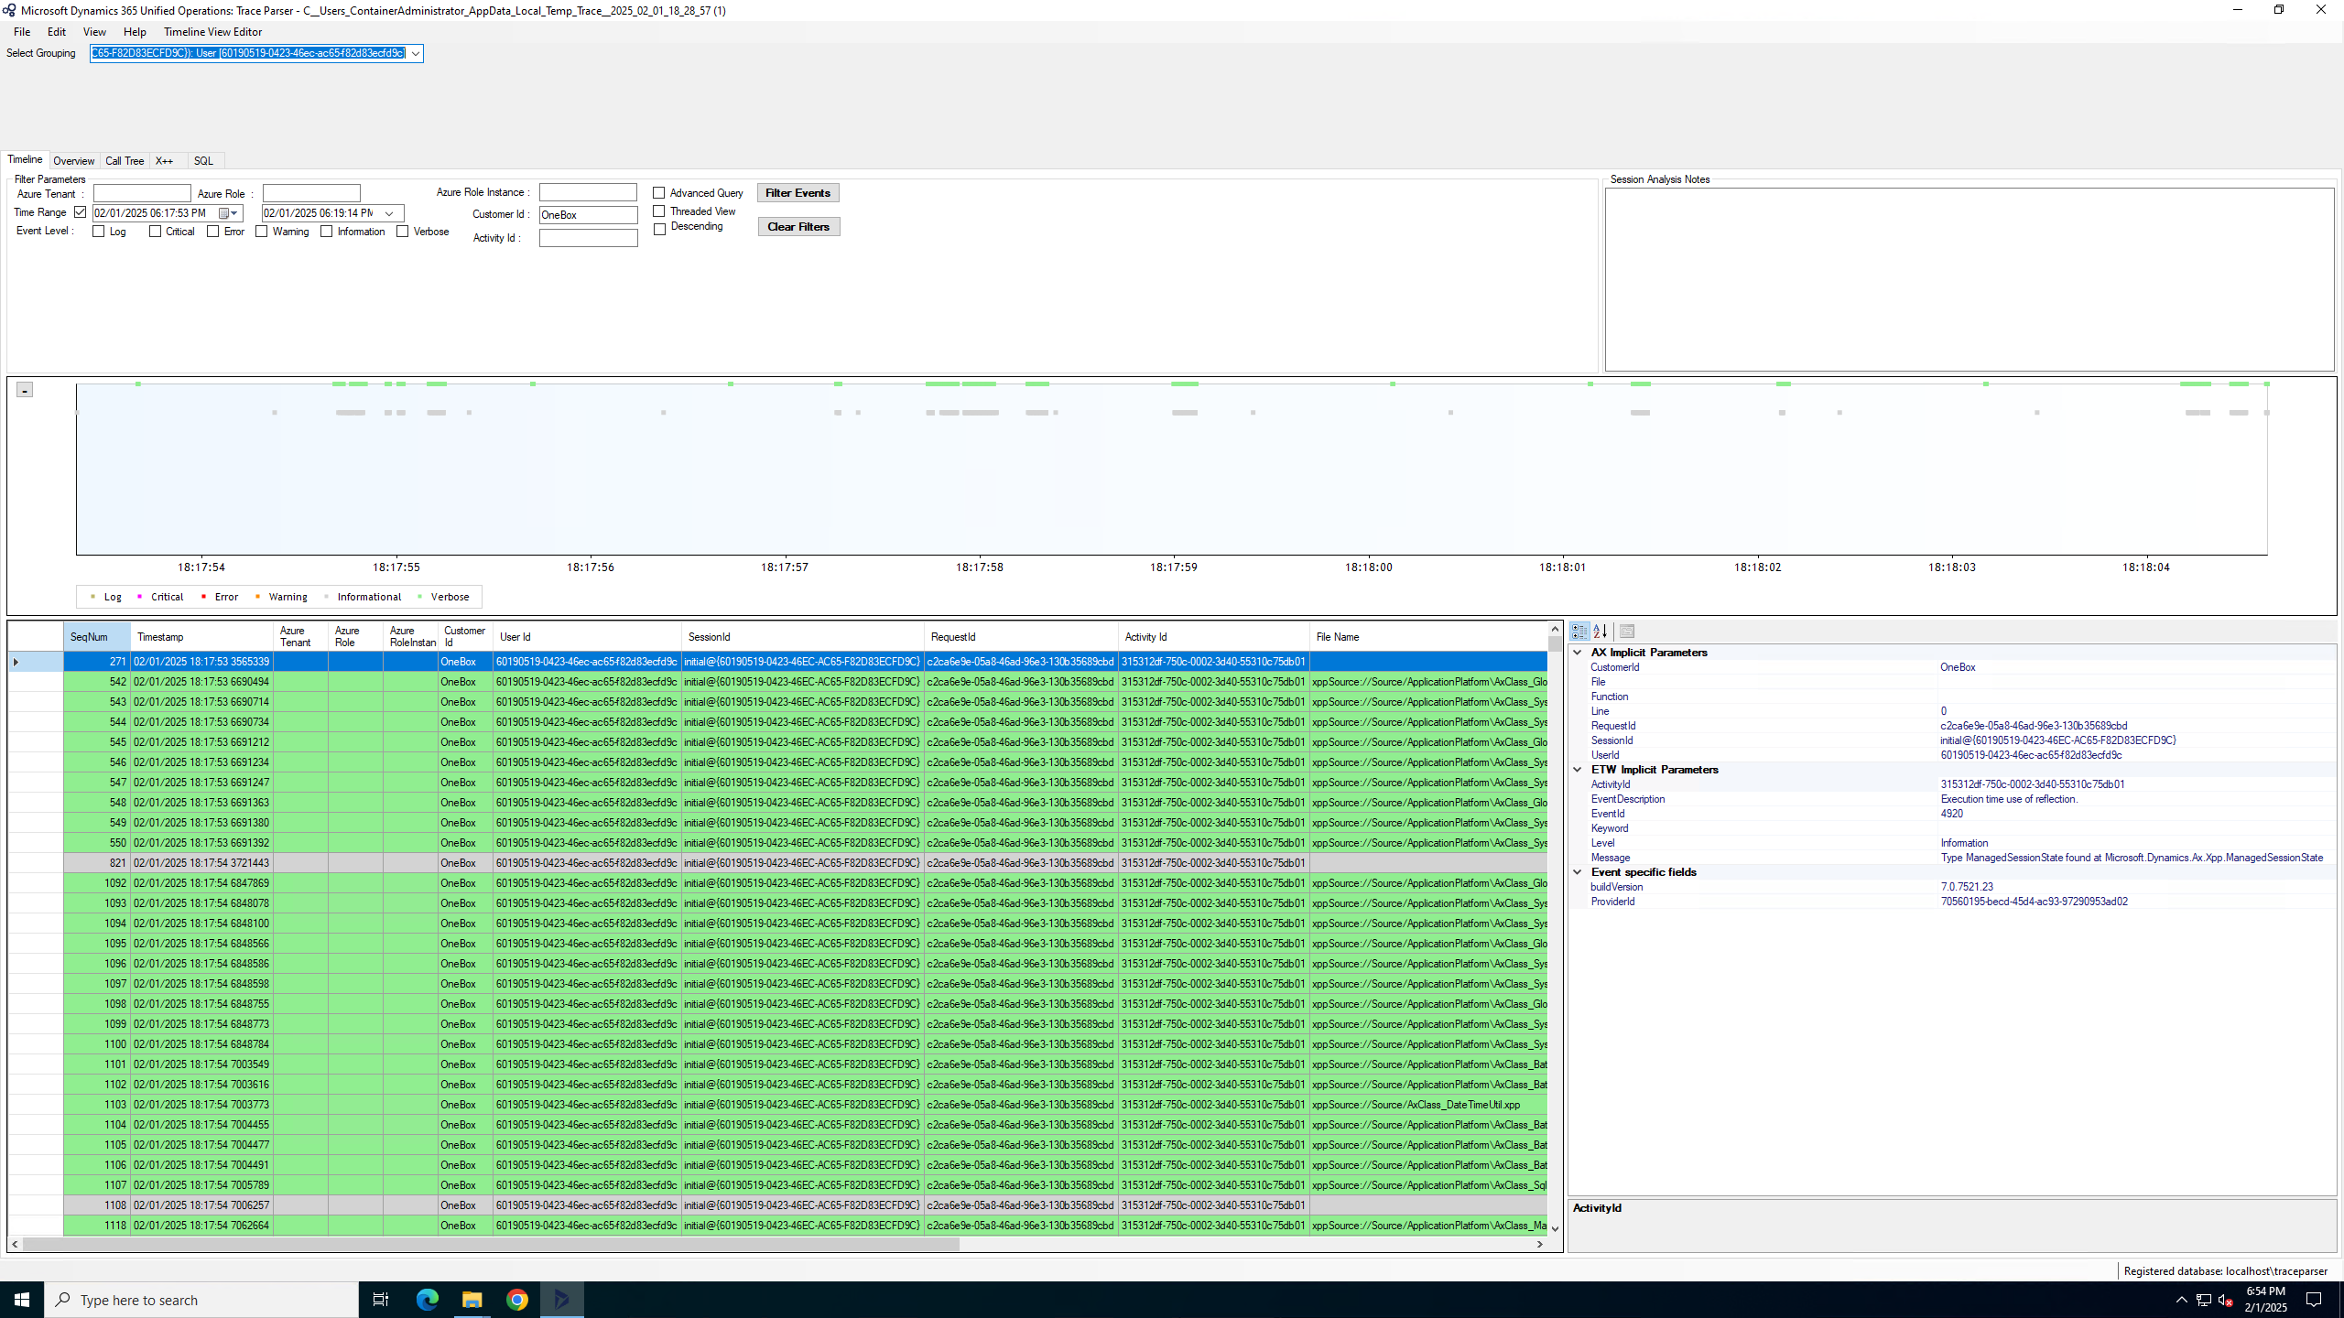

Slide 52
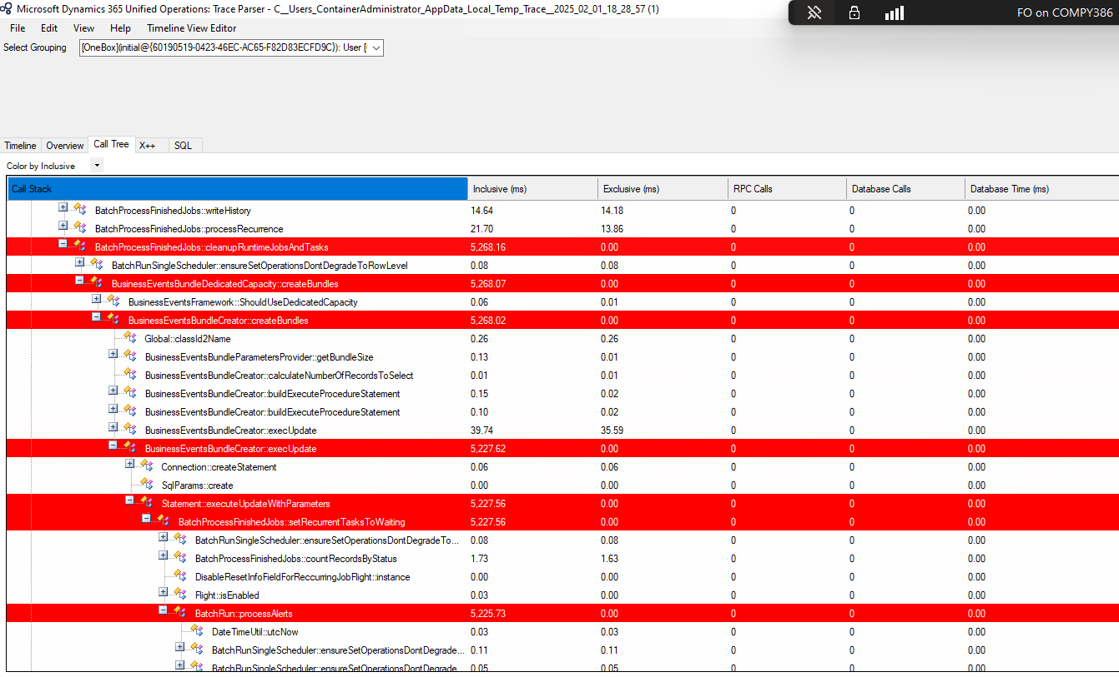

Slide 53
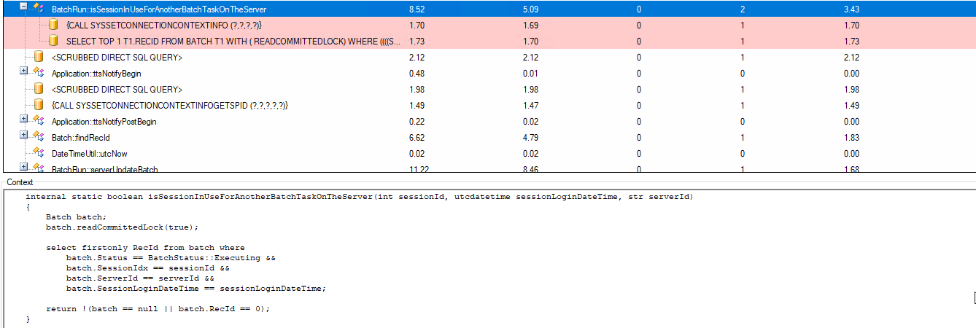

Slide 54
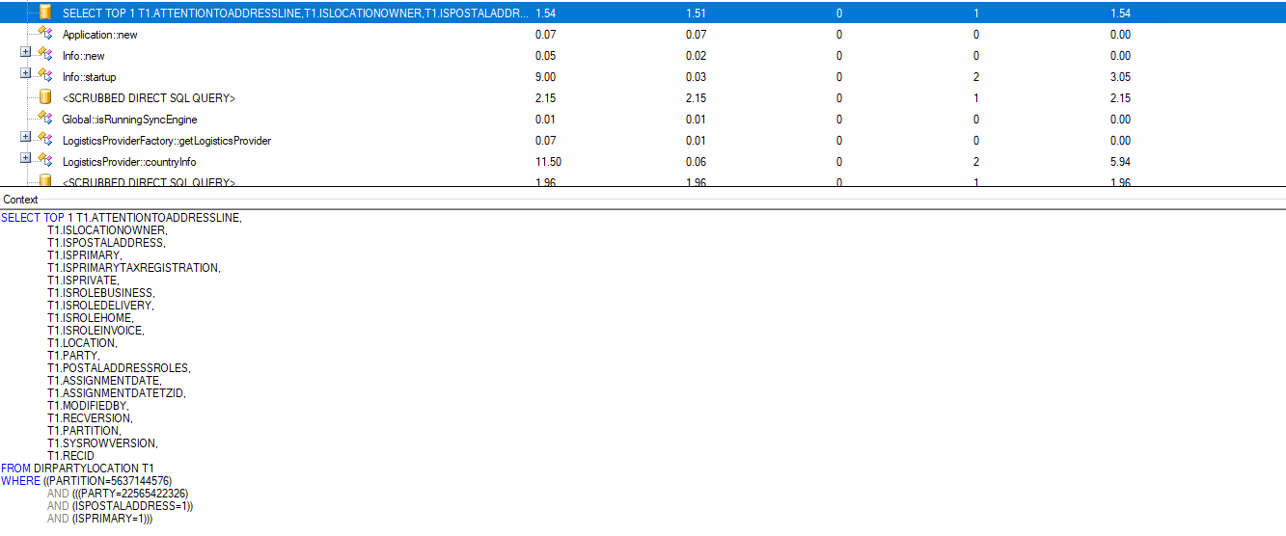

Slide 55

Common Problems
Poor Indexing of Tables
Missing Indexes / Indices
Not using indexes ( customizations )
Poor loop architectures

Slide 56
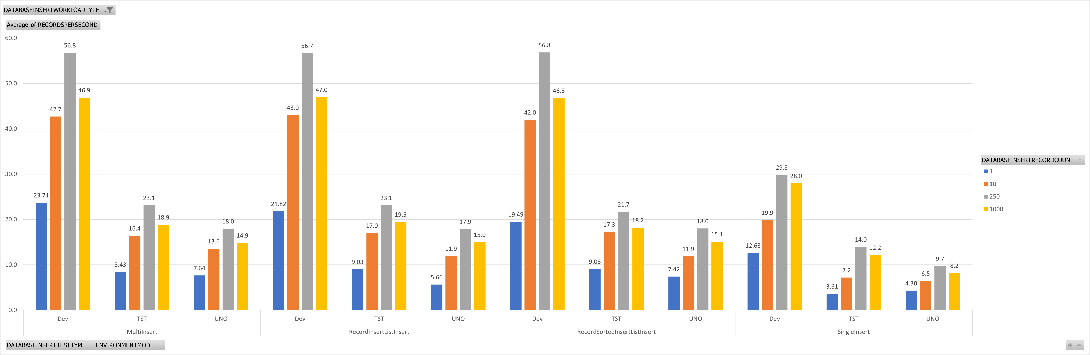

Slide 57

Fixing an Issue

Slide 58

Batch Jobs
Stagger
Tweak
rewrite

Slide 59

Stagger
Move batch job times
Invoice after hours
Run reports in the middle of the night
Determine order of operations
What needs to happen on transaction date
What needs to happen before the next day

Slide 60
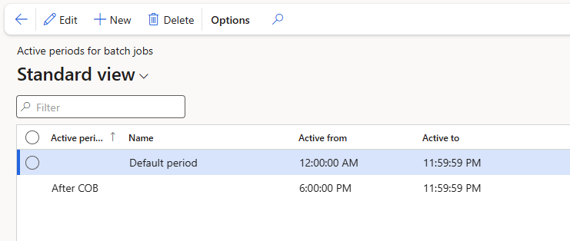
Stagger

Slide 61
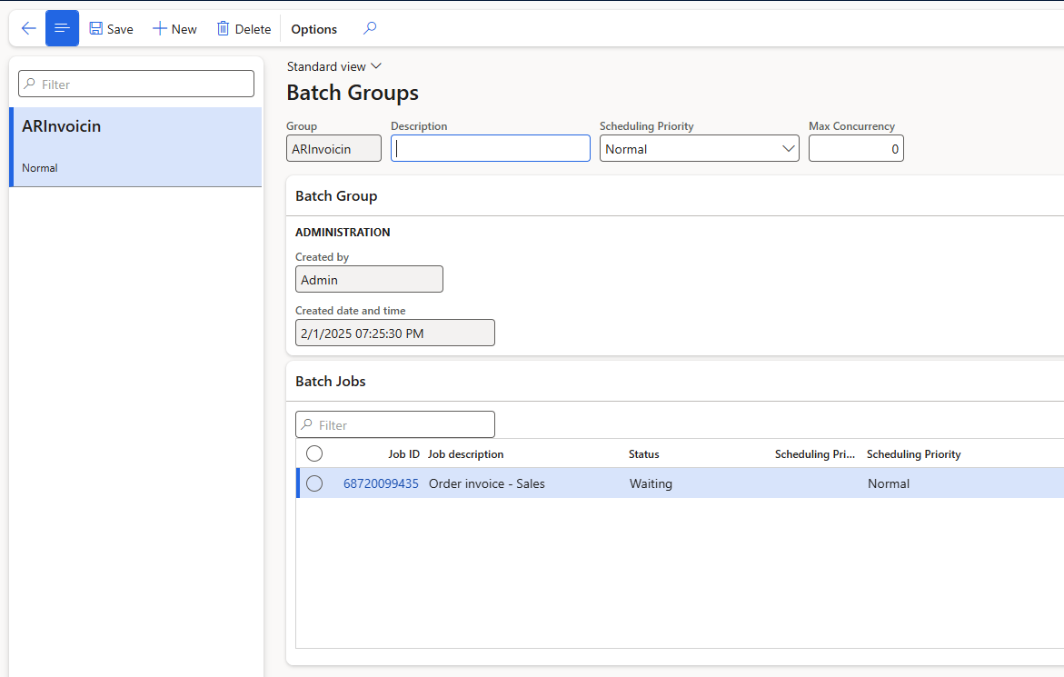
Stagger

Slide 62
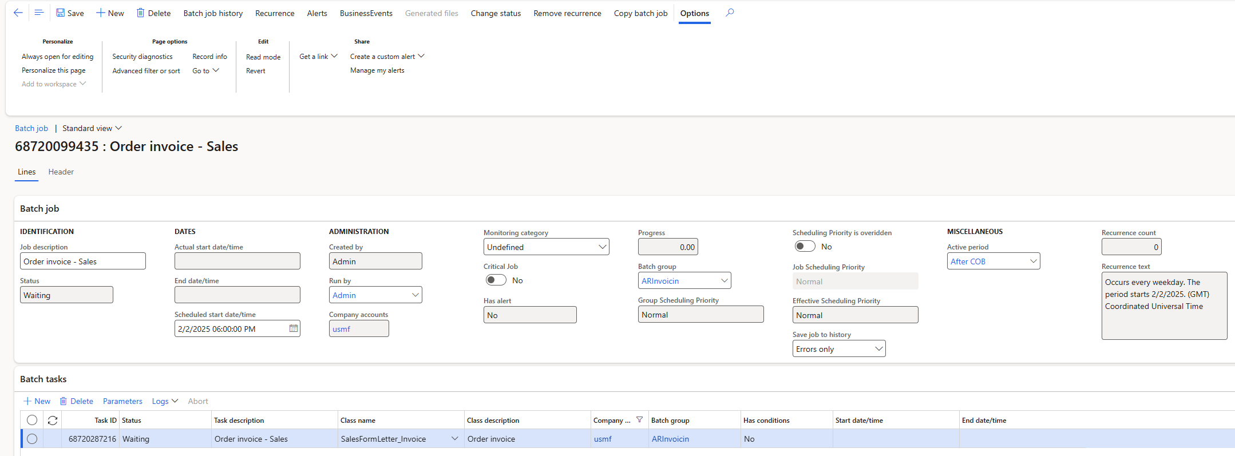

Slide 63

Tweak
Some batch jobs have new settings
Max threads
Bundle size
Etc.
New Features
Filter on “performance” in Feature Management workspace

Slide 64
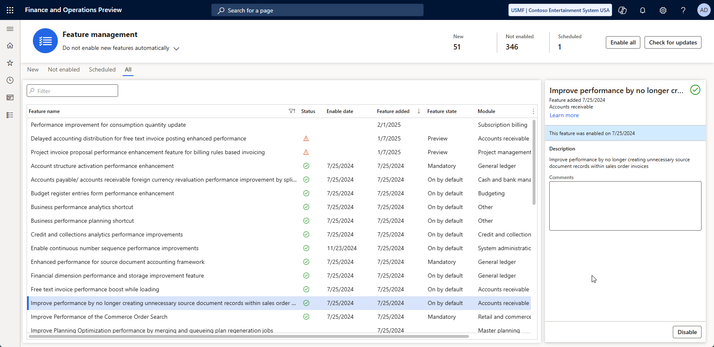

Slide 65
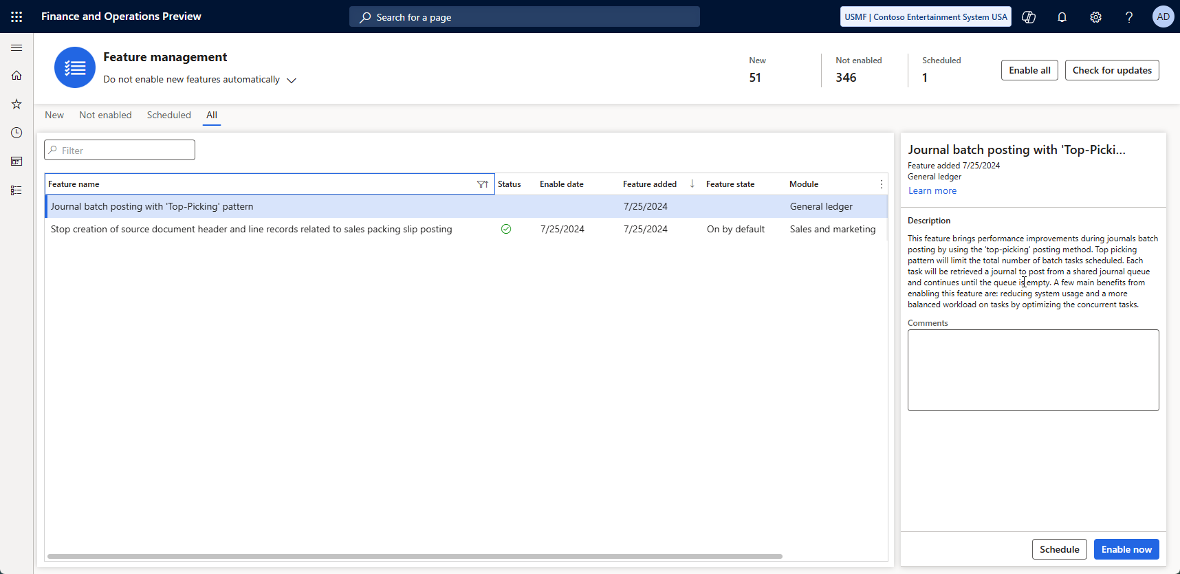
Notes:
Example – top-picking pattern

Slide 66

Tweak
Use Cleanup Batch jobs
Go to module > expand all > search for “Cleanup” or “clean”

Slide 67
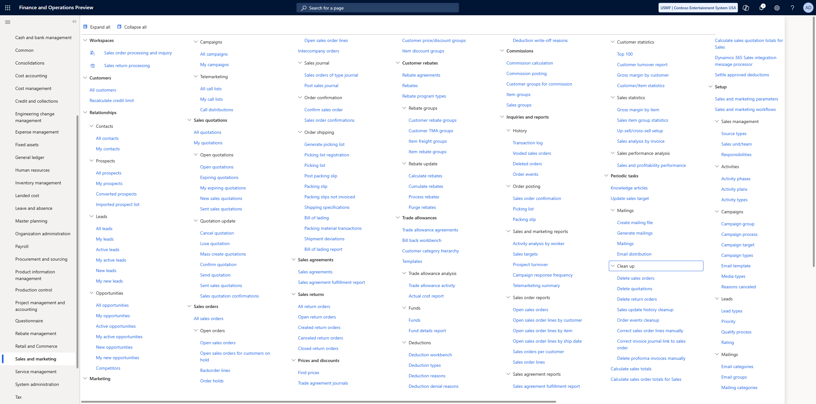

Slide 69
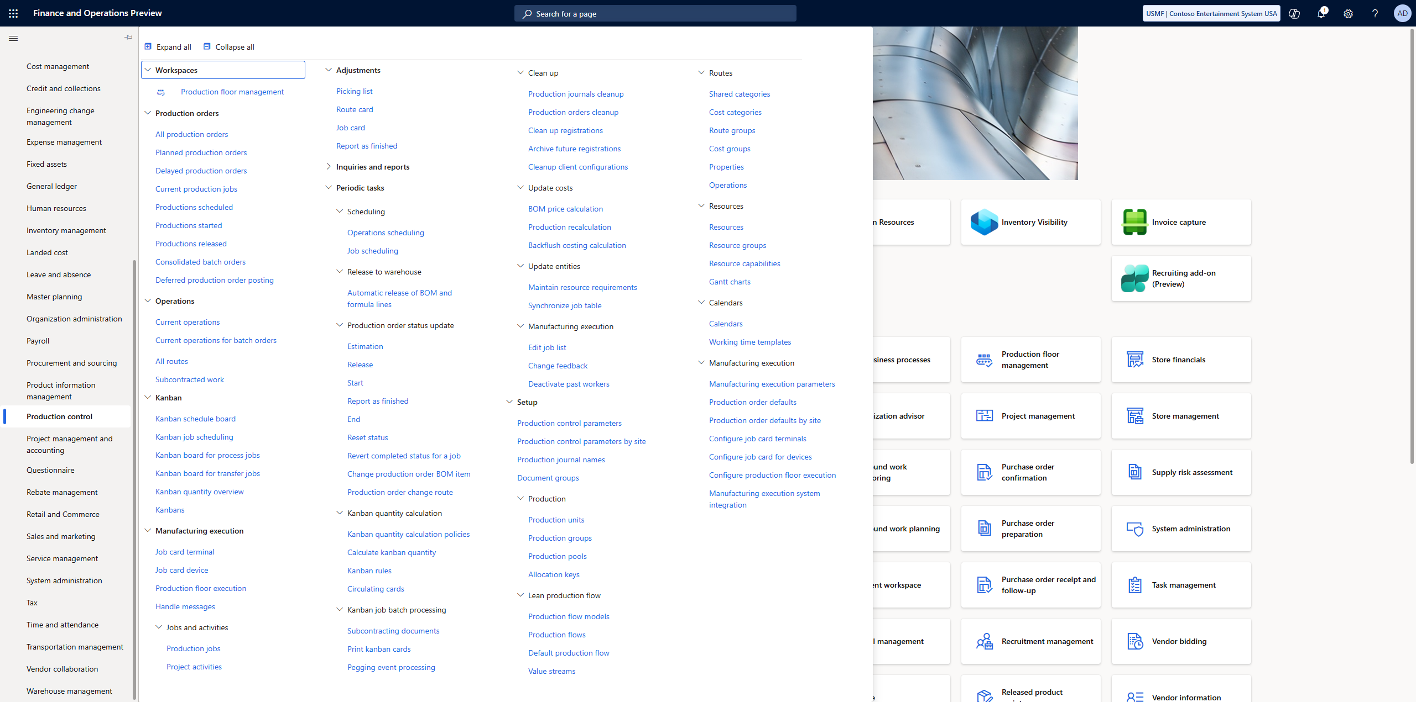

Slide 71
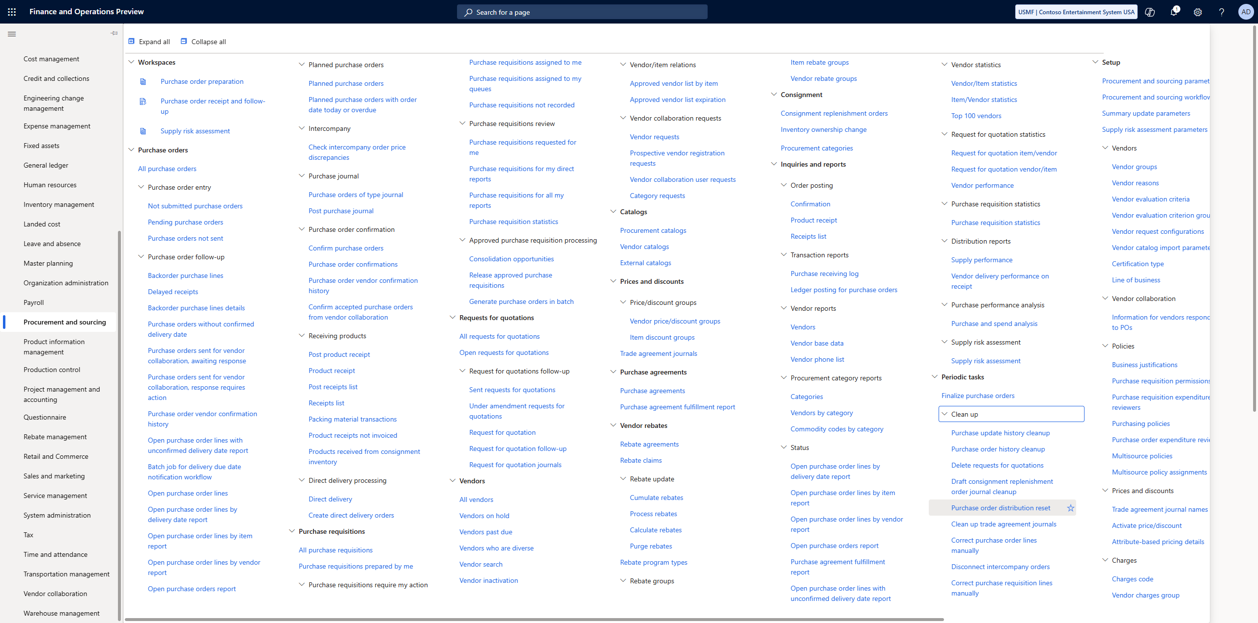

Slide 73
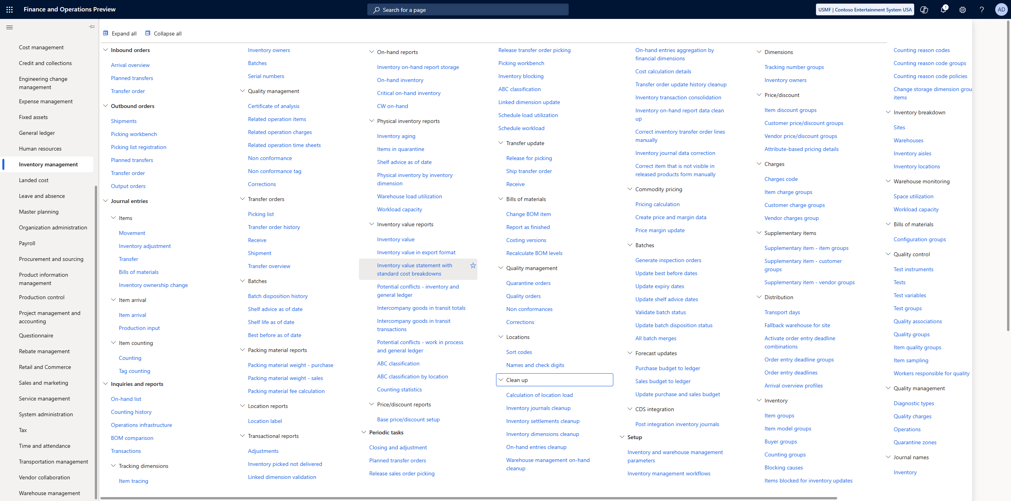

Slide 75

Custom Batch Jobs
“Classic” Batch Job
Individual Task Model
Batch-Bundle
Top-Picking
Each type has pros and cons

Slide 76

Custom Batch Jobs
Classic batch job
Slow but cheap
Single Threaded
Tried-and-True method that works
Individual Task Model
Fast but expensive
“all threaded”
Schedule everything and let batch sort it out

Slide 77

Custom Batch Jobs
Batch-Bundle
Moderate to Fast with some cost
Groups of tasks
Groups get completed 1 group at a time with multiple groups running at a time
Top-Picking
Fast with some temporal cost
“x threaded”
Setup x number of threads / lanes to execute all the work

Slide 78
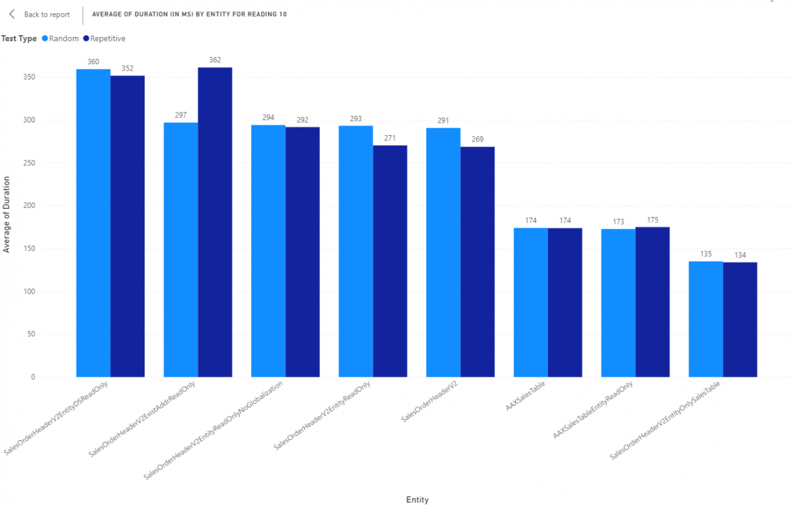
Data Entities Have A Similar Problem
Data entities from Microsoft are built for the world
Maybe not for you
Includes specializations in all countries Microsoft supports

Slide 80
Key Take-aways
Personalize screens and workspaces for your specific workload and remove unused fields
Explore new product offerings from Microsoft like data entities, features, misc.
Document and report slow processes for admins and developers to review

Slide 81
Key Take-aways
Use Batch, if possible, with alerts and workspaces to focus on completing tasks and highlighting work left to complete
Review processes for performance issues using traces. Report to Microsoft if internal problem or developers if a customization problem

Slide 82
Key Take-aways
Review database indexes ( if possible and appropriate )
Customize with targeted batch jobs
Customize for high performance ( if needed )

Slide 83
Suggested Resources

Slide 84
Thank you!
Nathan Clouse
Nathan.clouse@armanino.com
NathanClouseAX on LinkedIn and lots of other platforms

